Slide 1
ME8492 KINEMATICS OF MACHINERY
FRICTION IN MACHINE ELEMENTS
Kalaiselvan.K
AP/MECH
Velammal Institute Of technology

Slide 2
Bearings are machine elements
Bearings are designed to
⎝
⎝
⎝
reduce friction carry loads
guide moving parts

Slide 3
What is Friction ?
Friction is resistance to movement
⎝ it opposes sliding
⎝ it assists rotation

Slide 4
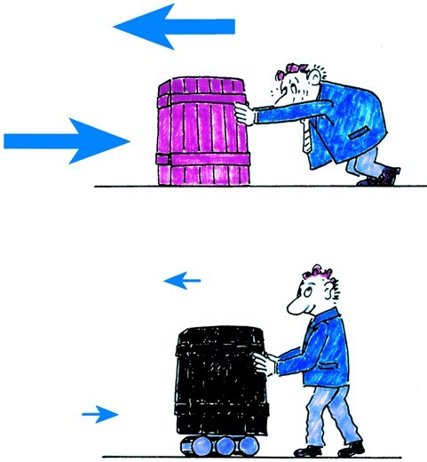
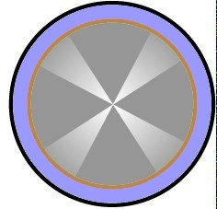
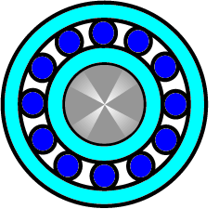
What is friction?
Plain bearings sliding friction
μ
Rolling bearings rolling friction
μ

Slide 5
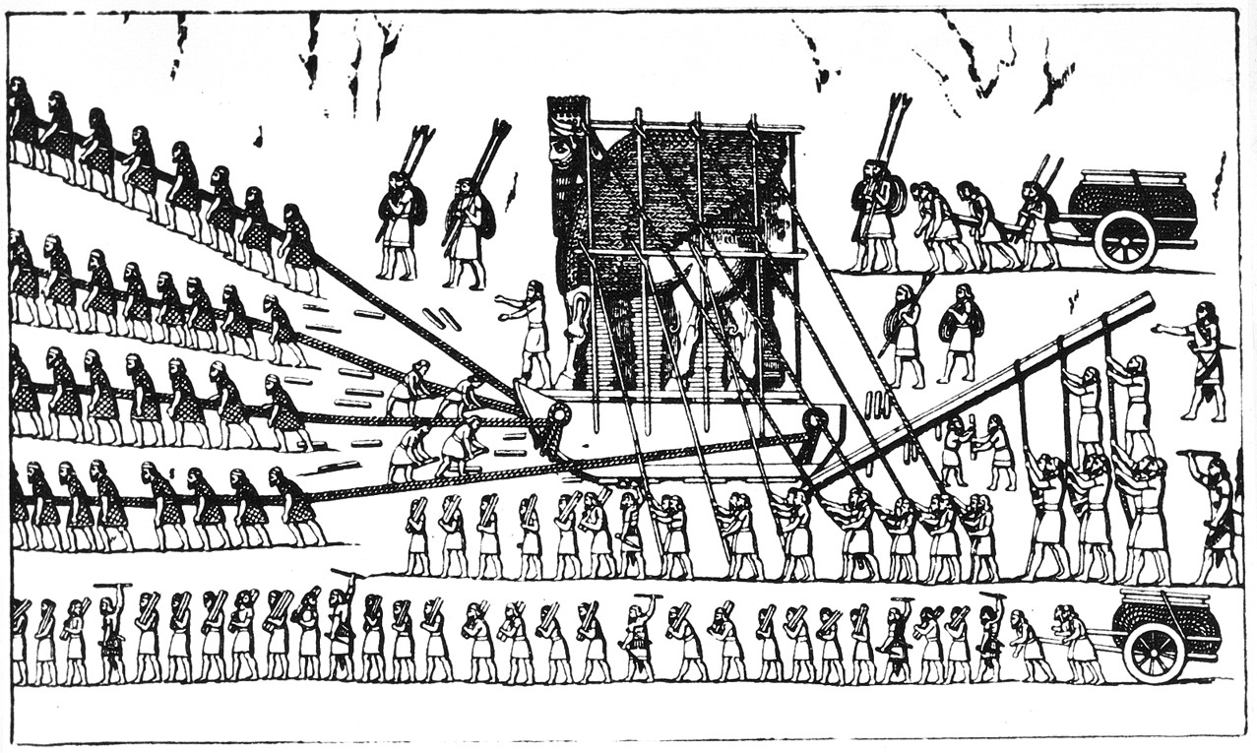
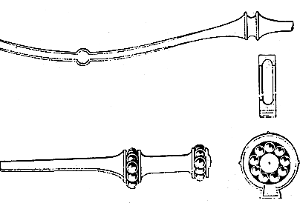
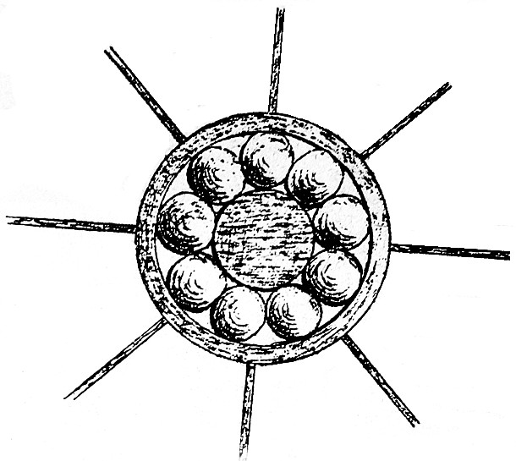
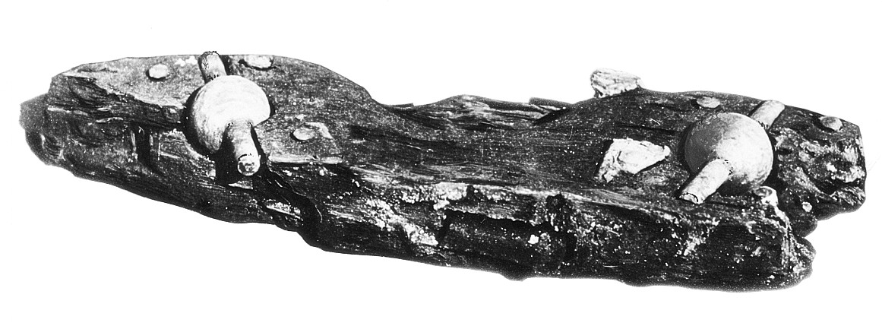
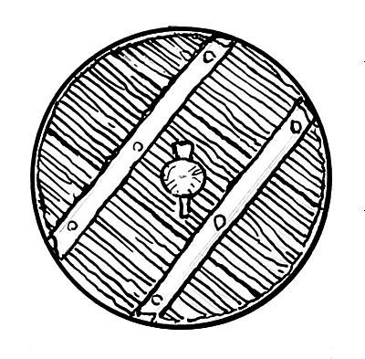
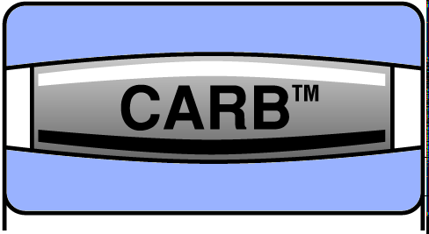
How did a bearing evolve ?
Bearing history - a never-ending story
1794
1869
1100 B.C.
40 A.D.
3500 B.C.
1995

Slide 6
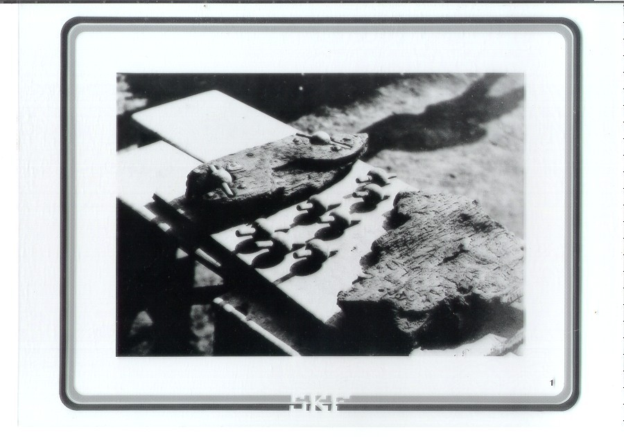
How did a bearing evolve ?

Slide 7
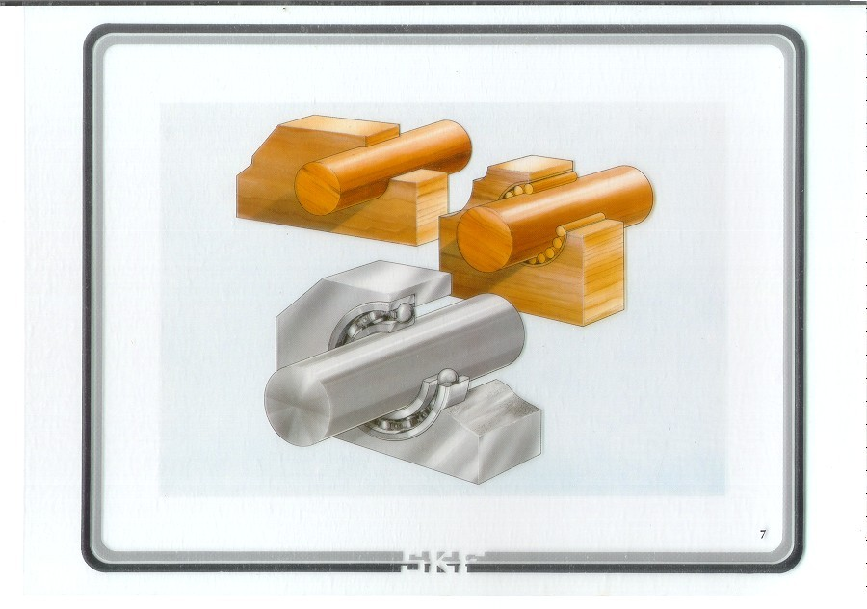
How did a bearing evolve ?
* Invention of wheel
Wheel rotates on axle
Wear Plate + Rollers
Inner ring + Outer ring
+ Rollers
With introduction of cage Rolling Bearing was created

Slide 8
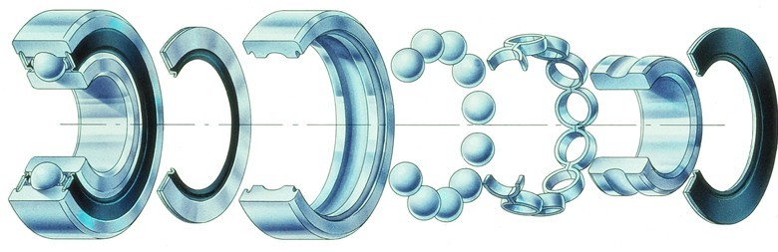
The components of a bearing
Seal
Rolling elements
Inner ring
Outer ring
Cage
Seal

Slide 9
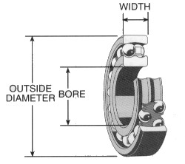

Bearing Basics
Pg. 7
Bearing Installation and Maintenance Guide

Slide 10

Bearing Basics
BALL
POINT CONTACT
SPHERICAL
LINE CONTACT
TAPERED
LINE CONTACT

Slide 11
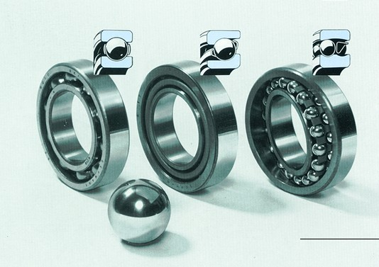
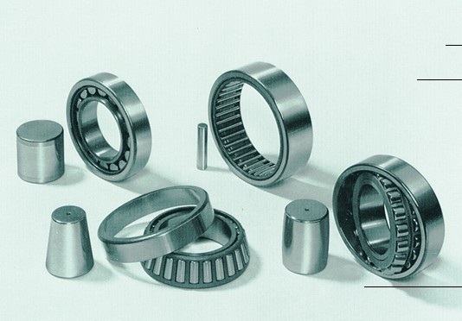
Characteristics
Ball bearings
Point Contact :
Deep groove Angular ball bearing contact
ball bearing
Self-aligning ball bearing
*
*
*
*
Less area of contact Less friction
More speed Less load
Roller bearings
Line Contact :
Cylindrical roller bearing
Taper Needle
roller roller bearing bearing
Spherical roller bearing
*
*
*
*
More area of contact More friction
Less speed More load

Slide 12

Rolling elements name the bearing
Ball
Spherical roller (symmetrical)
Spherical roller (asymmetrical)
Cylindrical roller
Taper roller
Needle roller

Slide 13
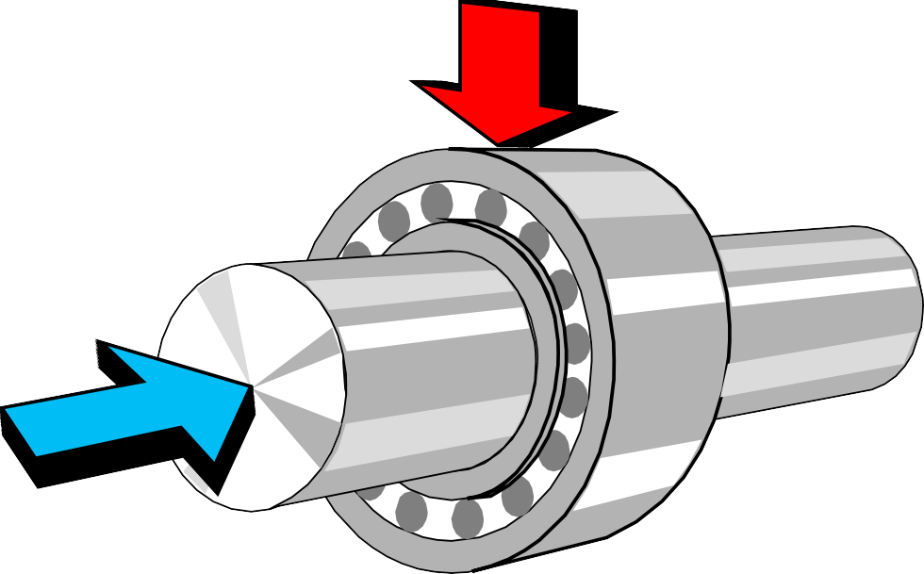
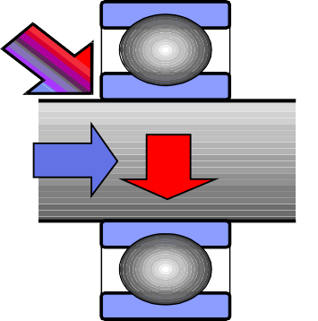
Bearing loads
Radial load
F_{r}
Combined load
Axial load
F_{a}

Slide 14
Radial rolling bearings
Radial rolling bearings
Ball bearings Roller bearings
Deep groove ball bearing
Angular contact
ball bearing
Self-aligning ball bearing
Cylindrical roller bearing
Taper roller
Needle roller
Spherical roller bearing
bearing bearing

Slide 15
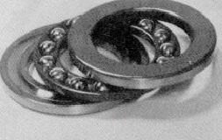
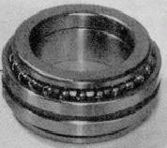
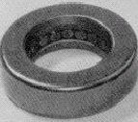
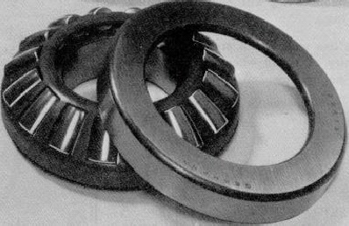
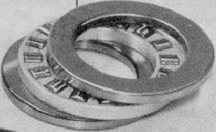
Thrust bearings
Ball bearings Roller bearings
Angular Contact Ball Thrust bearing
Taper Roller Thrust bearing
Spherical Roller Thrust bearing
Cylindrical
/ Needle
Roller Thrust bearing
Thrust
ball bearing

Slide 16
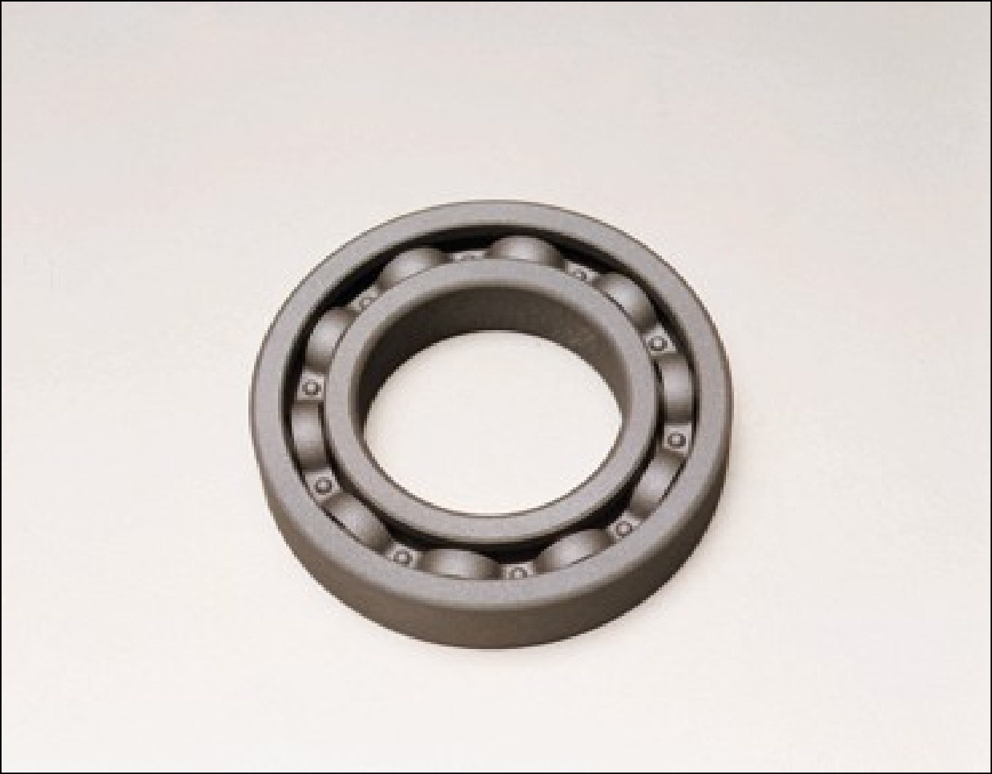
Deep Groove Ball Bearing

Slide 17
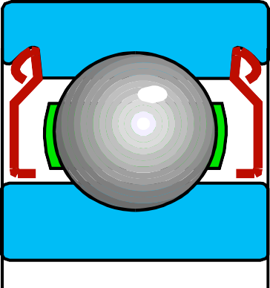
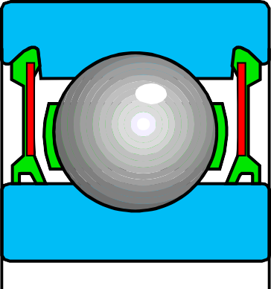
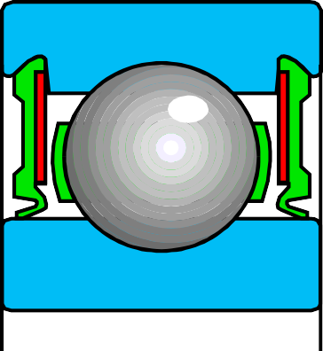
Bearings with shields and seals
Shields
Low-friction seals
Seals
-Z and -2Z
-RZ and -2RZ
-RS1 and -2RS1
Contaminant exclusion
Silent running
Grease retention
Speed capability

Slide 18
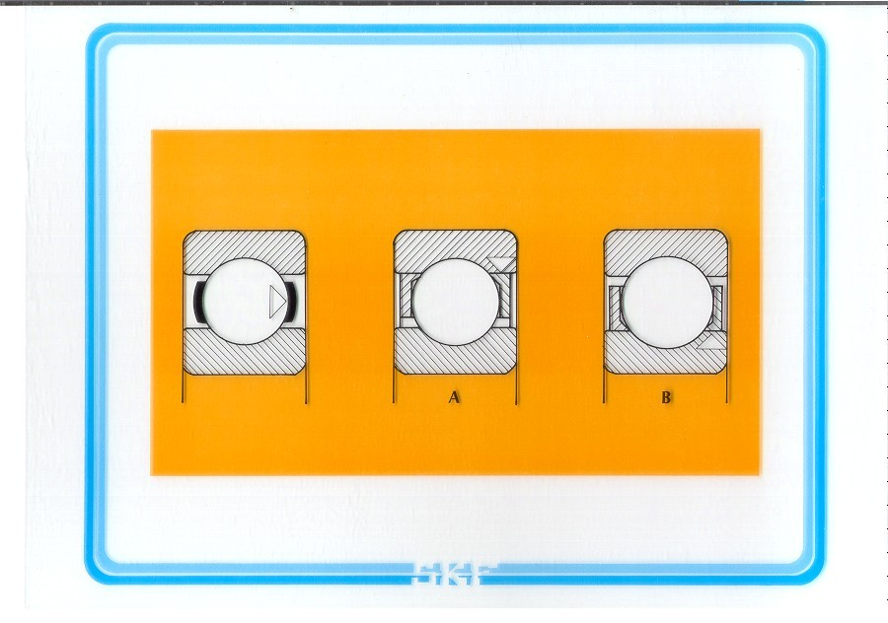

Slide 19
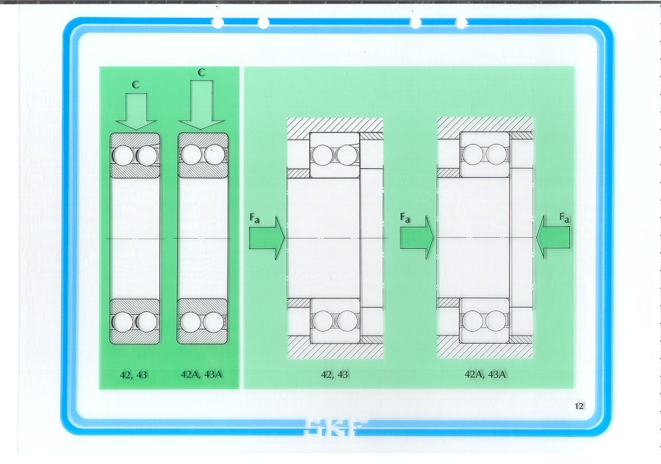

Slide 20
Misalignment
Parallel or offset misalignment Angular misalignment
Misalignments
produce additional stresses shorten bearing life increase seal wear increase vibration
increase noise
increase energy consumption
which will be avoided by proper shaft alignment or the use of a self-aligning bearing

Slide 21
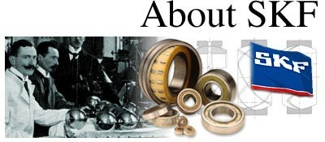
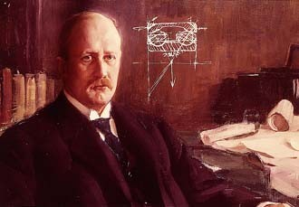
The industrial revolution has depended on a seldom recognized
component, the rolling bearing. So important is the rolling bearing that without it today's modern industry would
literally grind to a halt. From the beginning, SKF has led the world in
reducing friction with innovative rolling bearing solutions that have moved industry forward.
SKF was founded in Sweden in 1907 and grew out of Sven
Wingquist's solution to a misaligned drive shaft problem he faced in a textile mill. His invention of a double row self- aligning ball bearing was only the first of many innovations SKF has provided industry. From the first spherical rolling bearing to the current bearing life calculation methods used worldwide, SKF has pioneered the way with over 2,200 patents.

Slide 22
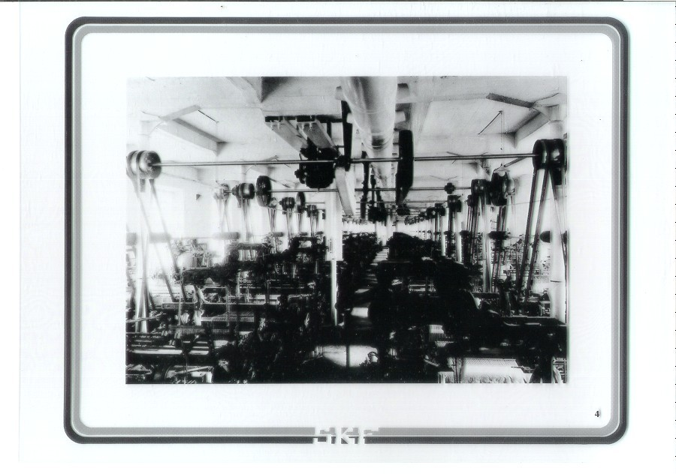

Slide 23
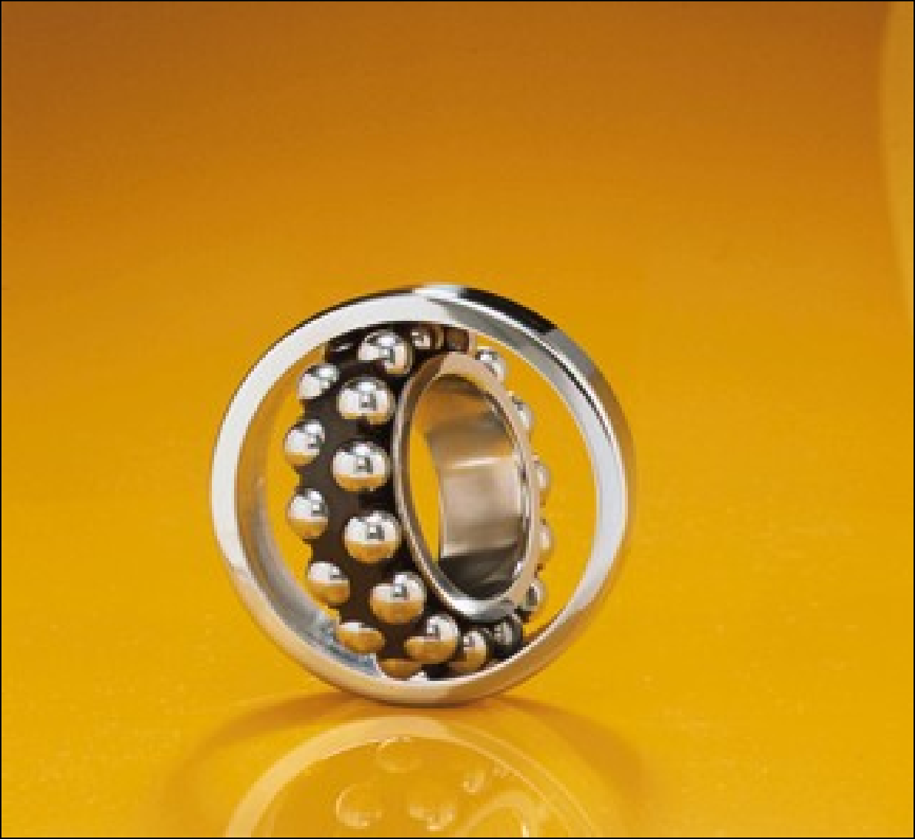
Self Aligning Ball Bearing

Slide 24
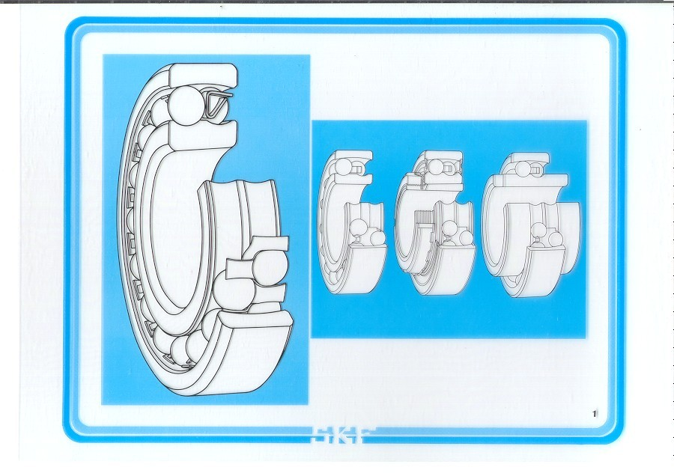

Slide 25
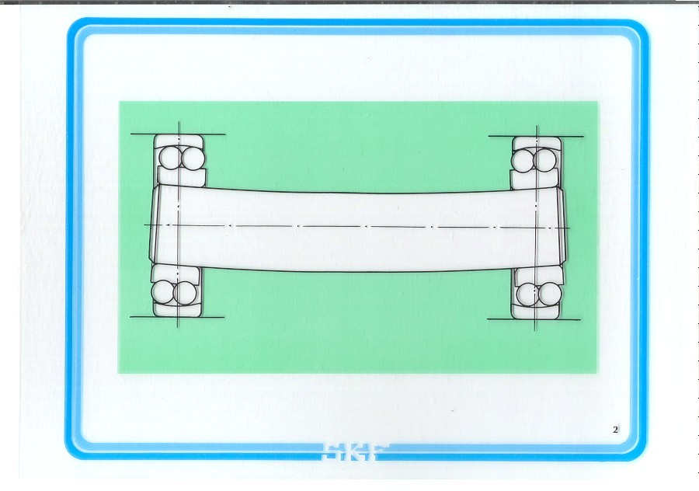

Slide 26
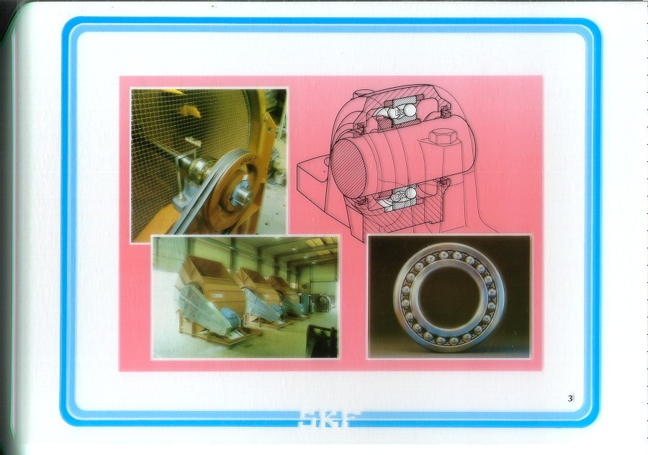

Slide 27
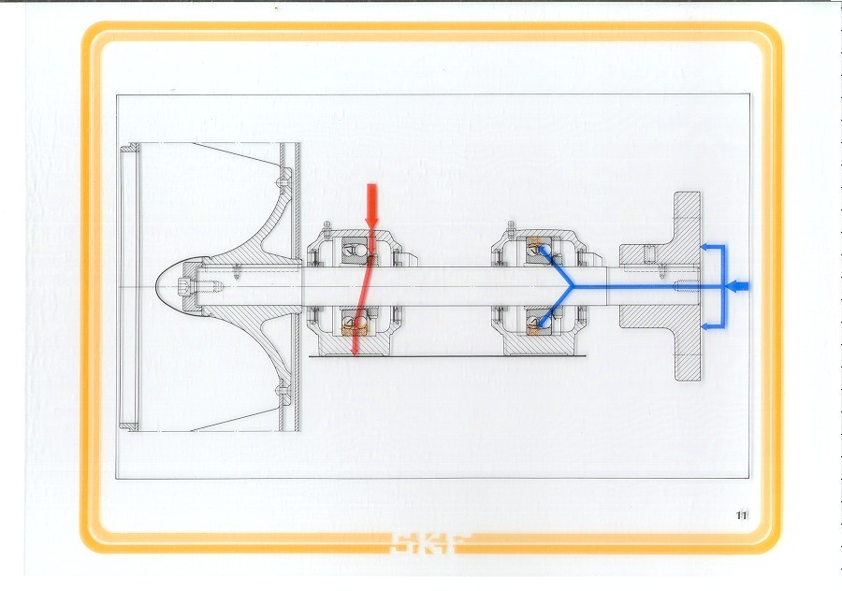

Slide 28
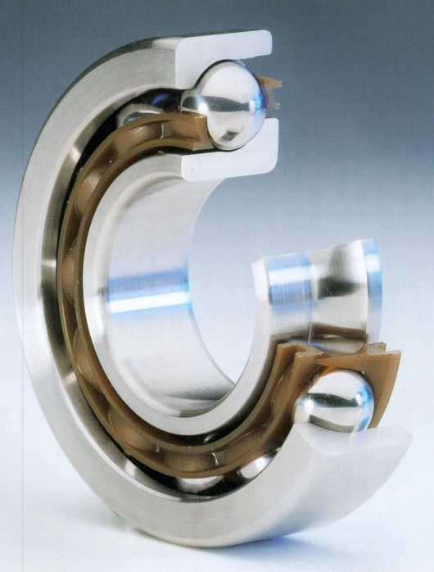
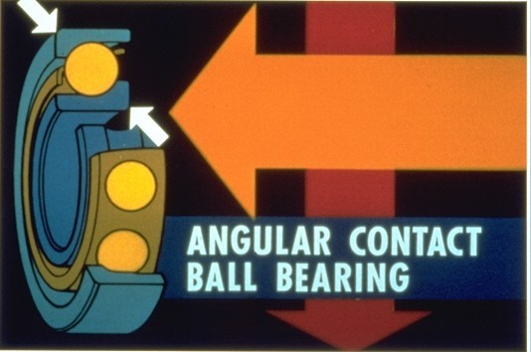
Bearing Basics

Slide 29
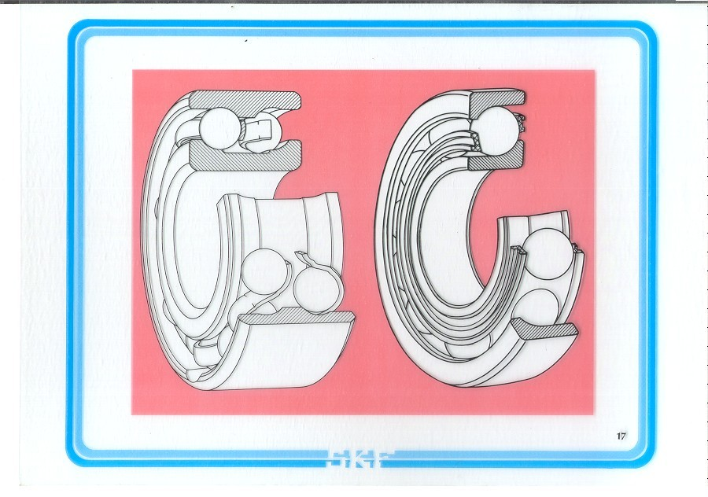

Slide 30
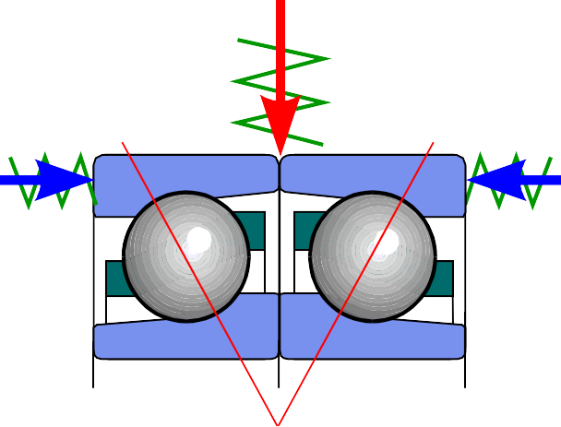
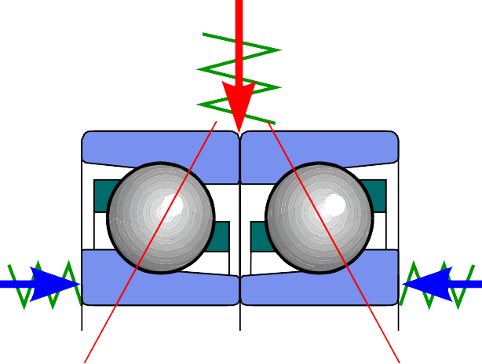
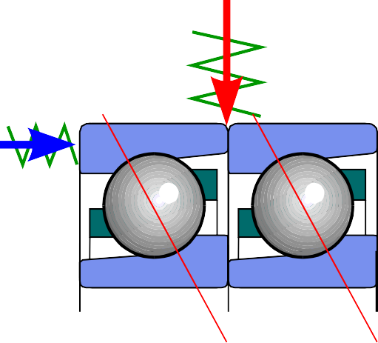
Paired mounting increases load carrying capacity and stiffness of the bearing arrangement
Face-to-face arrangement
e.g. 71906/DF
Back-to-back arrangement
e.g. 71906/DB
Tandem arrangement
e.g. 71906/DT
Force acting on bearing or set ^{Bearing stiffness (N/mm) =} Elastic deformation due to load

Slide 31
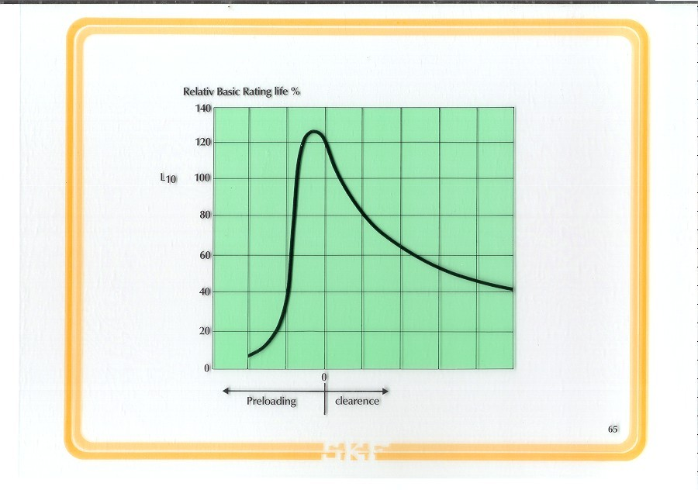

Slide 32
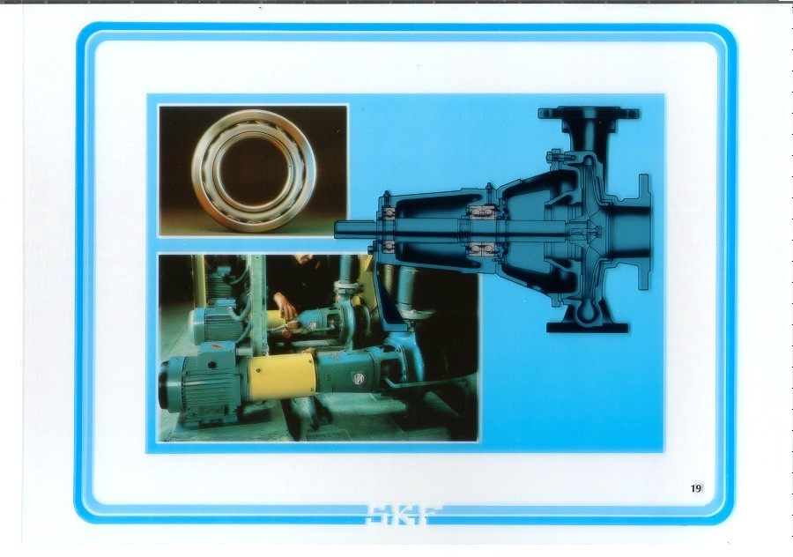

Slide 33
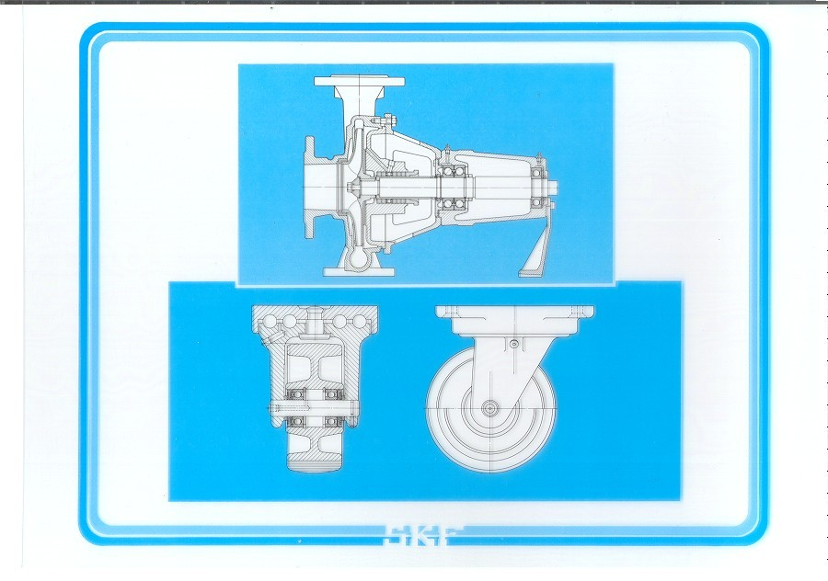

Slide 34
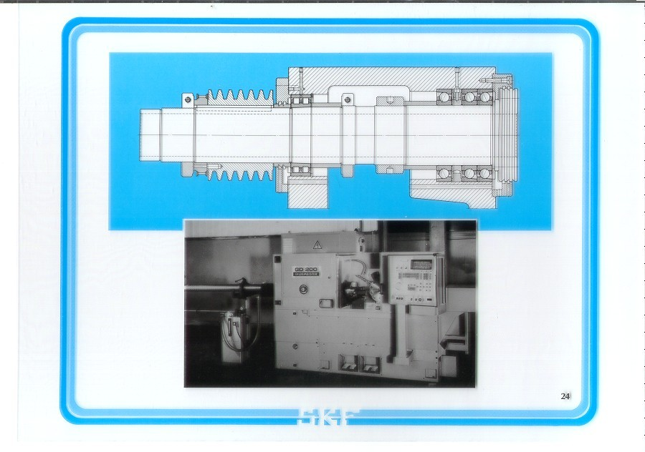

Slide 35
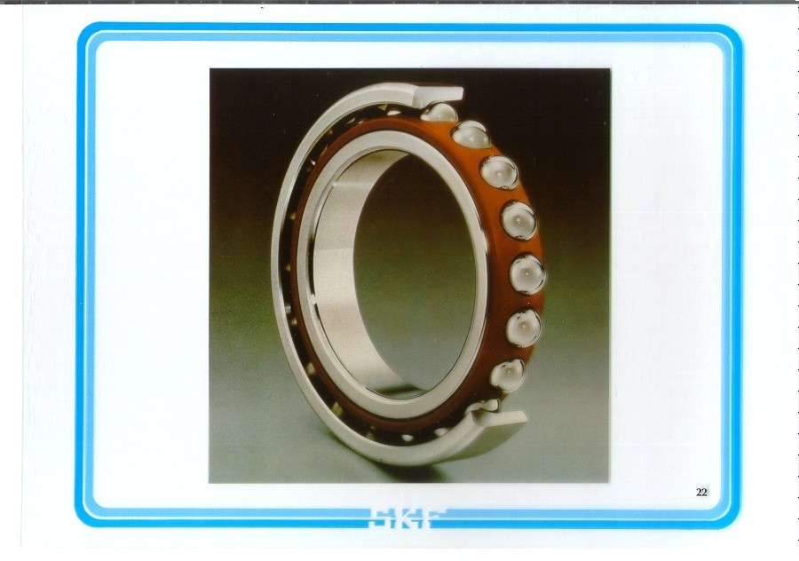

Slide 36
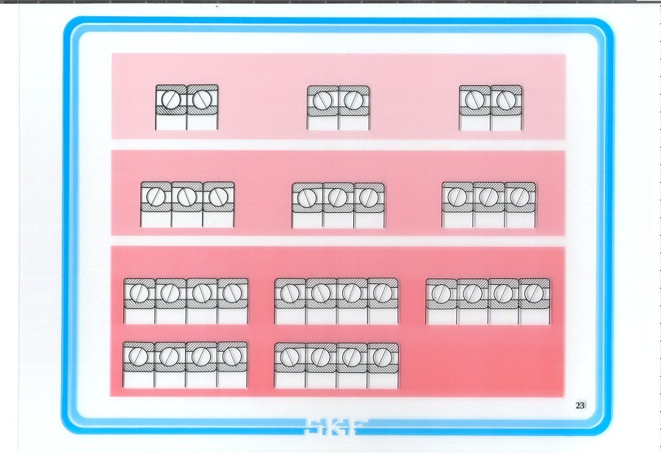

Slide 37
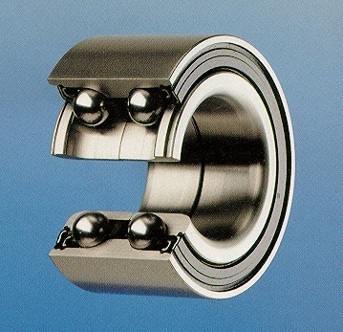
Double Row Angular Contact Ball Bearing

Slide 38
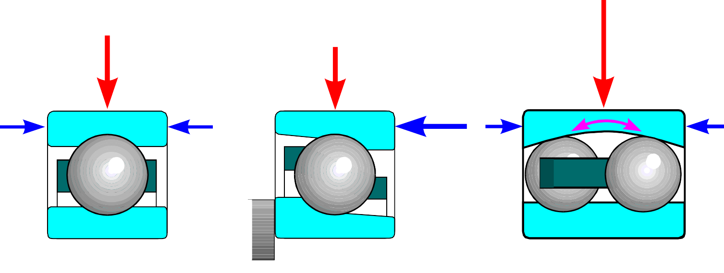
Ball bearing properties
Deep groove ball bearing
Angular contact Self-aligning ball bearing ball bearing
radial load carrying capacity
axial load carrying capacity
speed capability
can accommodate misalignment

Slide 39


Bearing Basics

Slide 40




Cylindrical roller bearings
NU
NJ
NUP
More and larger rollers
Logarithmic contact profile plus optimised surface finish
Improved roller end/flange contact geometry
3 cage variants: steel, polyamide, brass
N
NU+HJ
NJ+HJ

Slide 41


Slide 42


Slide 43


Slide 44

Bearing Basics

Slide 45

Bearing Basics

Slide 46


Bearing Basics

Slide 47




Spherical roller bearings
Symmetrical rollers
for maximum life under any conditions
Floating guide ring gives minimum friction and ensures reliable operation
Window-type steel cages strong and tolerant to high temperatures

Slide 48


Slide 49


Slide 50


Slide 51


Taper roller bearings
Taper rollers
for perfect rolling contact
Logarithmic profiled rollers
for protection from edge loading
Specially designed flange gives minimum friction and ensures reliable operation
Window-type steel cages strong and tolerant to high temperatures

Slide 52


Single row and paired single row taper roller bearings
Single row
Face-to-face arrangement suffix DF
Back-to-back arrangement suffix DB

Slide 53




Compact Aligning Roller Bearings CARBTM
Safer, more optimized design Increased service life
Lower running temperature Lower vibration and noise level Extended maintenance interval
Higher axial clearence No internal Friction force
Longer life Higher speed
Downsizing possibility

Slide 54

CARBTM - Bearing
Compact Aligning Roller Bearing
⎝ Self-aligning as spherical roller bearing
⎝ Permits axial displacements like a cylindrical roller bearing
⎝ Compact as a needle roller bearing

Slide 55





Thrust bearings
Thrust ball bearing single direction
Thrust ball bearing single direction with sphered housing washer
Thrust ball bearing double direction
Thrust ball bearing double direction with sphered housing washers
Cylindrical roller thrust bearing single direction
Spherical roller thrust bearing

Slide 56

Spherical roller thrust bearings
Combined load carrying capacity Can take 55% of thrust load as radial load
Logarithmic profiled rollers
for protection from edge loading
Specially designed flange gives minimum friction and ensures reliable operation
Window-type steel cages strong and tolerant to high temperatures

Slide 57
Compact Aligning Roller Bearings CARBTM
Safer, more optimized design Increased service life
Lower running temperature Lower vibration and noise level Extended maintenance interval
Higher axial clearence No internal Friction force
Longer life Higher speed
Downsizing possibility

Slide 58


Bearings are precision products
How much is a μm
Example: Tolerances for bore diameter 75 mm
A
human hair
Normal
Precision High precision
bearing bearing
1 μ
Standa
rd
P6
P5 SP
P4A UP
PA9A PA9B
Tolerance classes
0,06 mm
_{0/-7 μm} 0/-2,5 μm
_{0/-15 μm} 0/-12 μm ^{0/-9 μm}

Slide 59

Materials for rolling bearings
Bearing rings and rolling elements
Through-hardening steels
Carbon chromium steel containing approximately 1 % carbon and 1,5 % chromium
Case-hardening steels
Chromium-nickel alloyed steel
Manganese-chromium alloyed steel
appr. 0,20 % carbon
SKF bearing steels have very high cleanliness
– the content of macro and microinclusions is extremely low.

Slide 60







Cages keep the rolling elements separated
Prevent immediate contact between rolling elements to minimise friction and heat generation
Guide the rolling elements
Provide space for lubricant Serve to retain the rolling
elements when bearings of separable design are mounted or dismounted

Slide 61


Slide 62


Slide 63



Cage variants
Polyamide cage
+ lightweight
+ high elasticity
+ good sliding properties
+ good marginal lubrication
properties
- operating temperature
limit +120°C
Window-type steel cage
+ lightweight
+ high strength
+ no operating temperature
limit
+ high vibration and
acceleration resistance
- sensitive to poor
lubrication
Window-type brass cage
+ very high strength
+ very high vibration and
acceleration resistance
+ suitable for very high
speeds in connection with
circulating oil lubrication
- relatively expensive

Slide 64


Slide 65

Bearing clearance
Radial clearance
Axial
clearance

Slide 66


Slide 67




Clearance
Normal clearance
Reduced clearance because of tight fit
Increased clearance because of temperature
Suffix clearance
/C1 less than C2
/C2 less than Normal
/CN Normal
/C3 greater than Normal
/C4 greater than C3
/C5 greater than C4
Example:
6210/C3 = Deep groove ball bearing with clearance greater than Normal
CN does not normally appear in the bearing designation

