Slide 1
ME8492 KINEMATICS OF MACHINERY
Gears and Gear Trains
Kalaiselvan.K
AP/MECH
Velammal Institute Of technology

Slide 2
Sometimes, two or more gears are made to mesh with each other to transmit power from one shaft to another. Such a combination is called gear train or train of toothed wheels. The nature of the train used depends upon the velocity ratio required and the relative position of the axes of shafts. A gear train may consist of spur, bevel or spiral gears.
Types of Gear Trains:
Following are the different types of gear trains, depending upon the arrangement of wheels:
  Simple gear train,
  Compound gear train,
  Reverted gear train, and
  Epicyclic gear train

Slide 3
In the first three types of gear trains, the axes of the shafts over which the gears are mounted are fixed relative to each other. But in case of epicyclic gear trains, the axes of the shafts on which the gears are mounted may move relative to a fixed axis.

Slide 4
Simple Gear Train:
When there is only one gear on each shaft, as shown in Fig.1, it is known as simple gear train. The gears are represented by their pitch circles. When the distance between the two shafts is small, the two gears 1 and 2 are made to mesh with each other to transmit motion from one shaft to the other, as shown in Fig. (a). Since the gear 1 drives the gear 2, therefore gear 1 is called the driver and the gear 2 is called the driven or follower. It may be noted that the motion of the driven gear is opposite to the motion of driving gear.

Slide 5
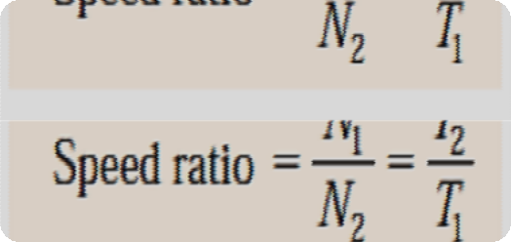

Let N1 = Speed of gear 1(or driver) in r.p.m.,
N2 = Speed of gear 2 (or driven or follower) in r.p.m., T1 = Number of teeth on gear 1, and
T2 = Number of teeth on gear 2.
Since the speed ratio (or velocity ratio) of gear train is the ratio of the speed of the driver to the speed of the driven or follower and ratio of speeds of any pair of gears in mesh is the inverse of their number of teeth, therefore

Slide 6
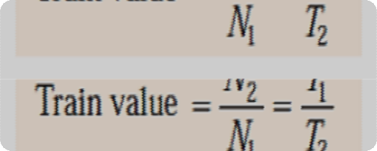

It may be noted that ratio of the speed of the driven or follower to the speed of the driver is
known as train value of the gear train. Mathematically,
Sometimes, the distance between the two gears is large. The motion from one gear to another, in such a case, may be transmitted by either of the following two methods :
By providing the large sized gear, or
By providing one or more intermediate gears.

Slide 7
A little consideration will show that the former method (i.e. providing large sized gears) is very inconvenient and uneconomical method ; whereas the latter method (i.e. providing one or more intermediate gear) is very convenient and economical.
It may be noted that when the number of intermediate gears are odd, the motion of both the gears (i.e. driver and driven or follower) is like as shown in Fig. (b).
But if the number of intermediate gears are even, the motion of the driven or follower will be
in the opposite direction of the driver as shown in Fig.(c).
Now consider a simple train of gears with one intermediate gear as shown in Fig.

Slide 8

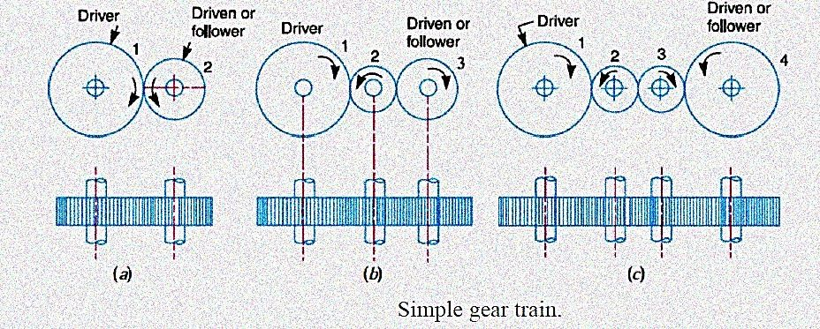

Slide 9
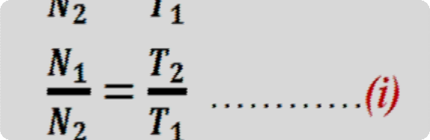

Let N1 = Speed of driver in r.p.m.,
N2 = Speed of intermediate gear in r.p.m., N3 = Speed of driven or follower in r.p.m., T1 = Number of teeth on driver,
T2 = Number of teeth on intermediate gear, and
T3 = Number of teeth on driven or follower.
Since the driving gear 1 is in mesh with the intermediate gear 2, therefore speed ratio for these
two gears is

Slide 10
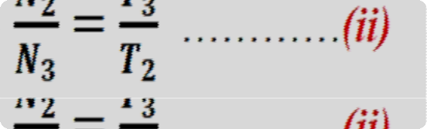

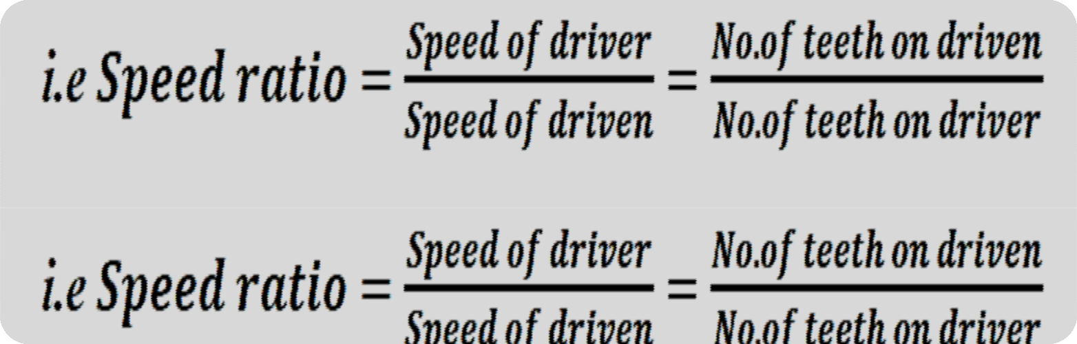

Similarly, as the intermediate gear 2 is in mesh with the driven gear 3, therefore speed ratio for these two gears is
The speed ratio of the gear train as shown in Fig. (b) is obtained by multiplying the equations
  and (ii).

Slide 11
From above, we see that the speed ratio and the train value, in a simple train of gears, is
independent of the size and number of intermediate gears.
These intermediate gears are called idle gears, as they do not affect the speed ratio or train value of the system. The idle gears are used for the following two purposes:
  To connect gears where a large centre distance is required, and
  To obtain the desired direction of motion of the driven gear (i.e. clockwise or anticlockwise).

Slide 12
Compound Gear Train:
When there is more than one gear on a shaft, it is called a compound train of gear.
We have seen in previous section that the idle gears, in a simple train of gears do not affect the speed ratio of the system. But these gears are useful in bridging over the space between the driver and the driven.
But whenever the distance between the driver and the driven or follower has to be bridged over by intermediate gears and at the same time a great ( or much less ) speed ratio is required, then the advantage of intermediate gears is intensified by providing compound gears on intermediate shafts..

Slide 13

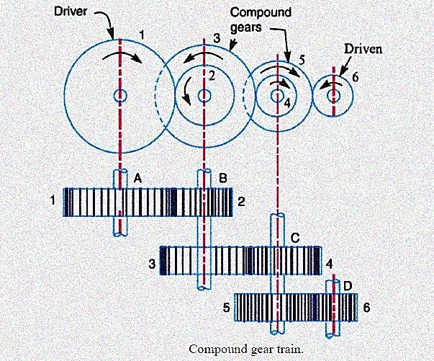
In this case, each intermediate shaft has two gears rigidly fixed to it so that they may have the same speed. One of these two gears meshes with the driver and the other with the driven or follower attached to the next shaft as shown in Fig.

Slide 14

In a compound train of gears, as shown in Fig. the gear 1 is the driving gear mounted on shaft A, gears 2 and 3 are compound gears which are mounted on shaft B. The gears 4 and 5 are also compound gears which are mounted on shaft C and the gear 6 is the driven gear mounted on shaft D.
Let N1 = Speed of driving gear 1,
T1 = Number of teeth on driving gear 1,
N2 ,N3 ..., N6 = Speed of respective gears in r.p.m., and
T2 ,T3..., T6 = Number of teeth on respective gears.
Since gear 1 is in mesh with gear 2, therefore its speed ratio is

Slide 15



Similarly, for gears 3 and 4, speed ratio is
and for gears 5 and 6, speed ratio is
The speed ratio of compound gear train is obtained by multiplying the equations (i), (ii)
and (iii),

Slide 16


Since gears 2 and 3 are mounted on one shaft B, therefore N2 = N3. Similarly gears 4 and 5
are mounted on shaft C, therefore N4 = N5.

Slide 17
The advantage of a compound train over a simple gear train is that a much larger speed reduction from the first shaft to the last shaft can be obtained with small gears.
If a simple gear train is used to give a large speed reduction, the last gear has to be very large. Usually for a speed reduction in excess of 7 to 1, a simple train is not used and a compound train or worm gearing is employed.
Note:The gears which mesh must have the same circular pitch or module. Thus gears 1 and 2 must have the same module as they mesh together. Similarly gears 3 and 4, and gears 5 and 6 must have the same module.

Slide 18
Example: The gearing of a machine tool is shown in Fig. The motor shaft is connected to gear A and rotates at 975
r.p.m. The gear wheels B, C, D and E are fixed to parallel shafts rotating together. The final gear F is fixed on the output shaft. What is the speed of gear F? The numbers of teeth on each gear are as given below:
Solution: Given: NA=975 r.p.m.; TA=20; TB=50; TC=25; TD=75; TE=26; TF=65
From Fig. we see that gears A, C and E are drivers while the gears B, D and F are driven or followers. Let the gear A rotates in clockwise direction. Since the gears B and C are mounted on the same shaft, therefore it is a compound gear and the direction or rotation of both these gears is same (i.e. anticlockwise).

Slide 19
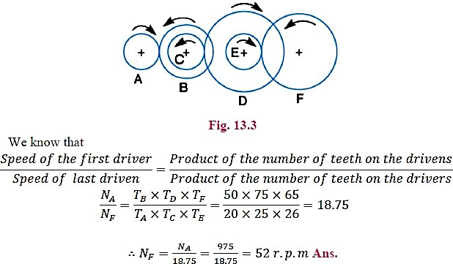
Similarly, the gears D and E are mounted on the same shaft, therefore it is also a compound gear and the direction
of rotation of both these gears is same (i.e. clockwise). The gear F will rotate in anticlockwise direction.
Let NF = Speed of gear F, i.e. last driven or follower.

Slide 20
Reverted Gear Train:
When the axes of the first gear (i.e. first driver) and the last gear (i.e. last driven or follower) are co-axial, then the gear train is known as reverted gear train as shown in Fig.
We see that gear 1 (i.e. first driver) drives the gear 2 (i.e. first driven or follower) in the opposite direction. Since the gears 2 and 3 are mounted on the same shaft, therefore they form a compound gear and the gear 3 will rotate in the same direction as that of gear 2.
The gear 3 (which is now the second driver) drives the gear 4 (i.e. the last driven or follower) in the same direction as that of gear 1. Thus we see that in a reverted gear train, the motion of the first gear and the last gear is like.

Slide 21
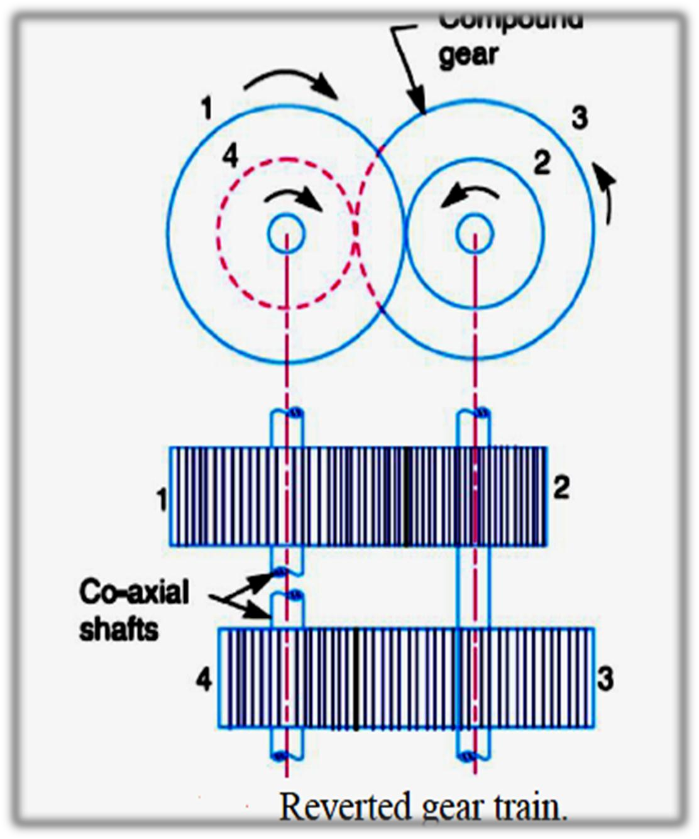
Let T1 = Number of teeth on gear 1,
r1 = Pitch circle radius of gear 1, and N1 = Speed of gear 1 in r.p.m.
Similarly,
T2, T3, T4 = Number of teeth on respective gears,
r2, r3, r4 = Pitch circle radii of respective gears, and
N2, N3, N4 = Speed of respective gears in r.p.m.

Slide 22
Since the distance between the centers of the shafts of gears 1 and 2 as well as gears 3 and 4 is same, therefore
r1 + r2 = r3 + r4 ...(i)
Also, the circular pitch or module of all the gears is assumed to be same, therefore number of
teeth on each gear is directly propertional to its circumference or radius.

Slide 23

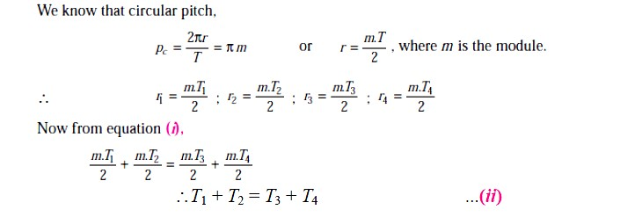

Slide 24
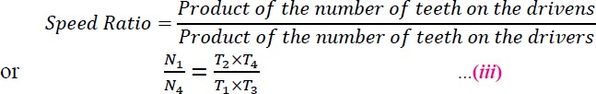
From equations (i), (ii) and (iii), we can determine the number of teeth on each gear for the given centre distance, speed ratio and module only when the number of teeth on one gear is chosen arbitrarily. The reverted gear trains are used in automotive transmissions, lathe back gears, industrial speed reducers, and in clocks (where the minute and hour hand shafts are co-axial).

Slide 25
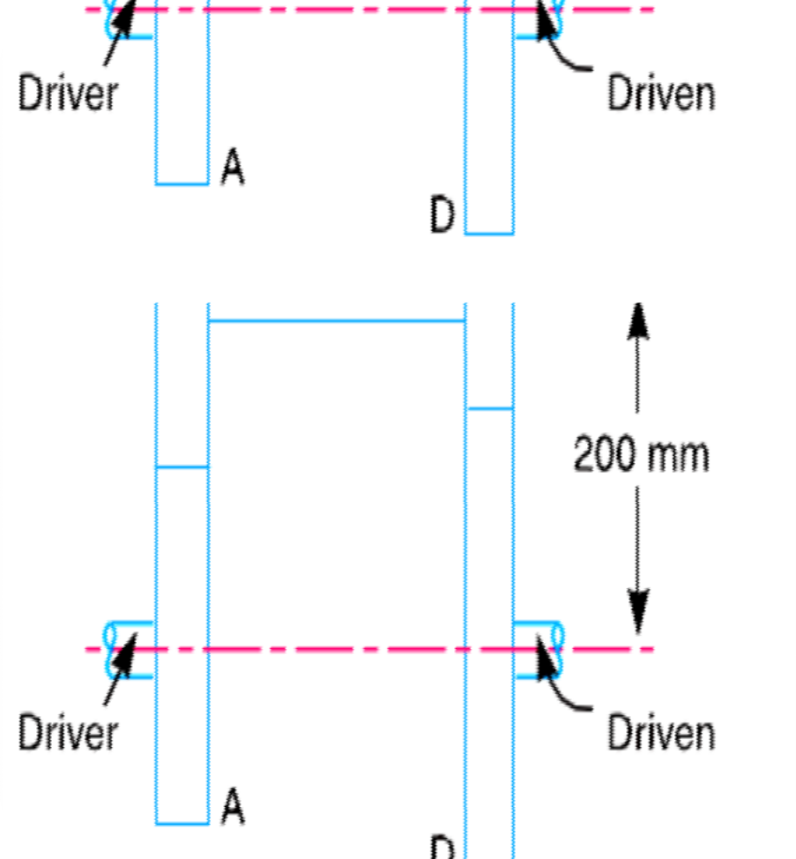

Example : The speed ratio of the reverted gear train, as shown in Fig.is to be 12. The module pitch of gears A and B is 3.125 mm and of gears C and D is
2.5 mm. Calculate the suitable numbers of teeth for
the gears. No gear is to have less than 24 teeth.

Slide 26
Solution: Given :
Speed ratio, NA/ND = 12 ;
mA = mB = 3.125 mm ; mC = mD = 2.5 mm
Let NA = Speed of gear A,
TA = Number of teeth on gear A, rA = Pitch circle radius of gear A,
NB, NC , ND = Speed of respective gears,
TB, TC , TD = Number of teeth on respective gears, and rB, rC , rD = Pitch circle radii of respective gears.

Slide 27
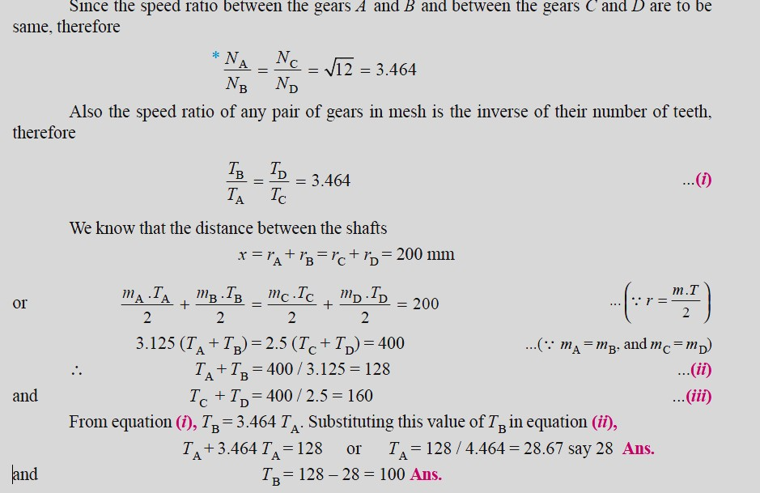

Slide 28

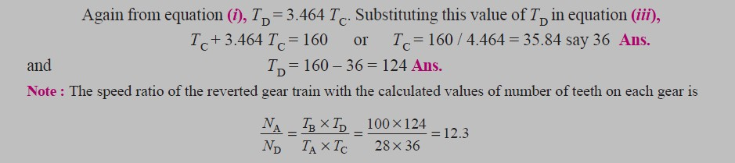

Slide 29
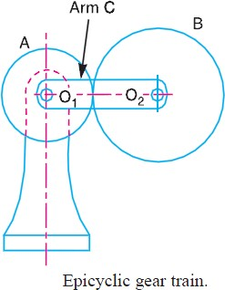
Epicyclic Gear Train
We have already discussed that in an epicyclic gear train, the axes of the shafts, over which the gears are mounted, may move relative to a fixed axis.
A simple epicyclic gear train is shown in Fig. where a gear A and the arm C have a common axis at O1 about which they can rotate.
The gear B meshes with gear A and has its axis on the arm at O2, about which the gear B can rotate.

Slide 30
If the arm is fixed, the gear train is simple and gear A can drive gear B or vice- versa, but if gear A is fixed and the arm is rotated about the axis of gear A (i.e. O1), then the gear B is forced to rotate upon and around gear A. Such a motion is called epicyclic and the gear trains arranged in such a manner that one or more of their members move upon and around another member are known as epicyclic gear trains (epi. means upon and cyclic means around).
The epicyclic gear trains may be simple or compound. The epicyclic gear trains are useful for transmitting high velocity ratios with gears of moderate size in a comparatively lesser space. The epicyclic gear trains are used in the back gear of lathe, differential gears of the automobiles, hoists, pulley blocks, wrist watches etc.

Slide 31
Velocity Ratios of Epicyclic Gear Train:
The following two methods may be used for finding out the velocity ratio of an epicyclic gear
train. 1. Tabular method, and 2. Algebraic method.
These methods are discussed, in detail, as follows:
1. Tabular method.: Consider an epicyclic gear train as shown in Fig.
Let TA = Number of teeth on gear A, and TB = Number of teeth on gear B.
First of all, let us suppose that the arm is fixed. Therefore the axes of both the gears are also fixed relative to each other. When the gear A makes one revolution anticlockwise, the gear B will make TA / TB revolutions, clockwise

Slide 32
Assuming the anticlockwise rotation as positive and clockwise as negative, we may say that when gear A makes + 1 revolution, then the gear B will make (– TA / TB) revolutions. This statement of relative motion is entered in the first row of the table (see Table 13.1).
Secondly, if the gear A makes + x revolutions, then the gear B will make ( – x × TA / TB ) revolutions. This statement is entered in the second row of the table. In other words, multiply the each motion (entered in the first row) by x.
Thirdly, each element of an epicyclic train is given + y revolutions and entered in the third row.
Finally, the motion of each element of the gear train is added up and entered in the fourth row.

Slide 33

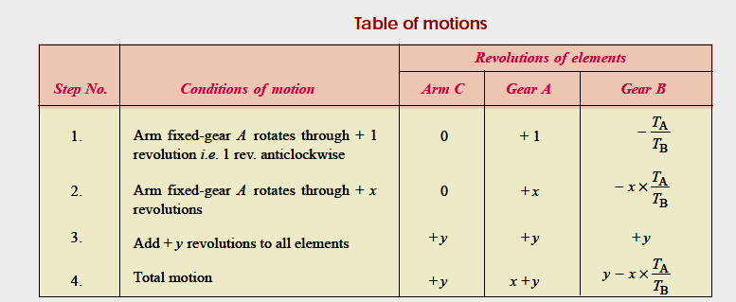

Slide 34
A little consideration will show that when two conditions about the motion of rotation of any two elements are known, then the unknown speed of the third element may be obtained by substituting the given data in the third column of the fourth row.
2. Algebraic method: In this method, the motion of each element of the epicyclic train
relative to the arm is set down in the form of equations.
The number of equations depends upon the number of elements in the gear train. But the two conditions are, usually, supplied in any epicyclic train viz. some element is fixed and the other has specified motion.
These two conditions are sufficient to solve all the equations ; and hence to determine the
motion of any element in the epicyclic gear train.

Slide 35


Let the arm C be fixed in an epicyclic gear train as shown in Fig. 13.6. Therefore speed of the
gear A relative to the arm C
= NA – NC
and speed of the gear B relative to the arm C,
= NB – NC
Since the gears A and B are meshing directly, therefore they will revolve in opposite directions.

Slide 36


Since the arm C is fixed, therefore its speed, NC = 0.

Slide 37

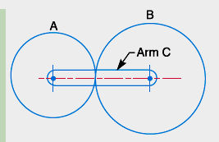
Example : In an epicyclic gear train, an arm carries two gears A and B having 36 and 45 teeth respectively. If the arm rotates at 150 r.p.m. in the anticlockwise direction about the centre of the gear A which is fixed, determine the speed of gear B. If the gear A instead of being fixed, makes 300 r.p.m. in the clockwise direction, what will be the speed of gear B
?
Solution:
Given : TA = 36 ; TB = 45 ; NC = 150 r.p.m.
(anticlockwise)

Slide 38
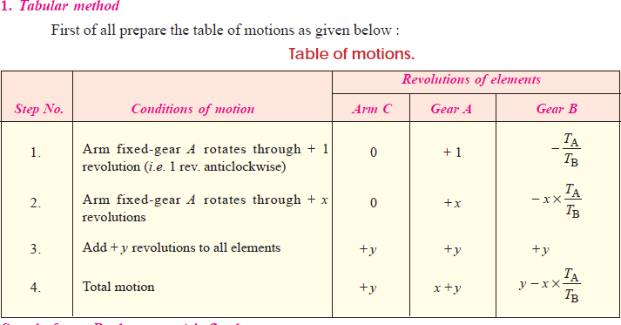

Slide 39

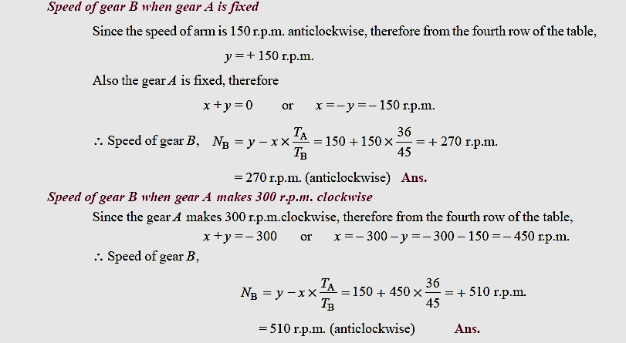

Slide 40
2. Algebraic method
Let NA = Speed of gear A.
NB = Speed of gear B, and
NC = Speed of arm C.
Assuming the arm C to be fixed, speed of gear A relative to arm C
= NA – NC
and speed of gear B relative to arm C = NB – NC

Slide 41

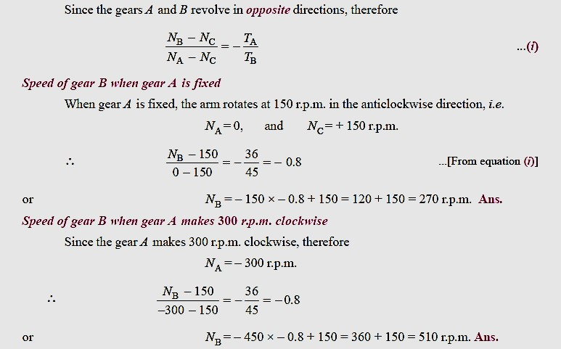

Slide 42

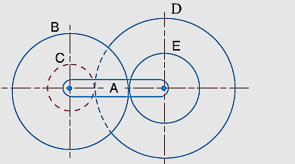
In a reverted epicyclic gear train, the arm A carries two gears B and C and a compound gear D - E. The gear B meshes with gear E and the gear C meshes with gear D. The number of teeth on gears B, C and D are 75, 30 and 90 respectively.
Find the speed and direction of gear C when gear B is fixed and the arm A makes 100 r.p.m. clockwise

Slide 43
Given : TB = 75 ; TC = 30 ; TD = 90 ; NA = 100 r.p.m. (clockwise)
The reverted epicyclic gear train is shown in Fig. First of all, let us find the number of teeth on gear E (TE). Let dB , dC , dD and dE be the pitch circle diameters of gears B, C, D and E respectively. From the geometry of the figure,
dB + dE = dC + dD
Since the number of teeth on each gear, for the same module, are proportional to their pitch circle diameters, therefore
TB + TE = TC + TD

Slide 44

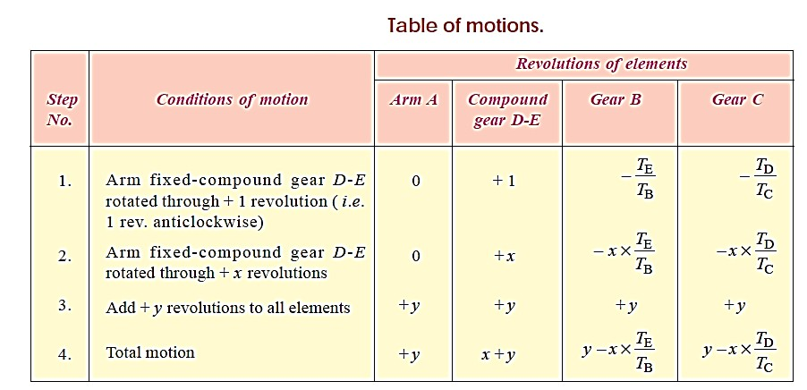
∴ TE = TC + TD – TB = 30 + 90 – 75 = 45
The table of motions is drawn as follows :

Slide 45

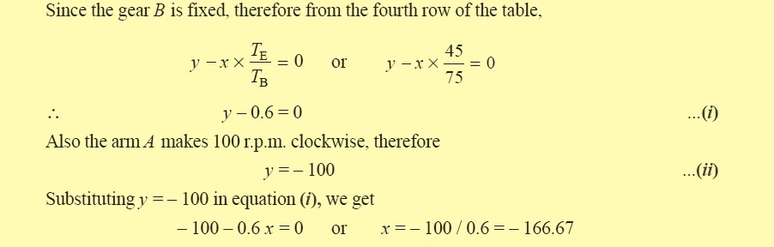

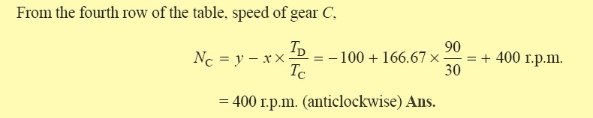

Slide 46

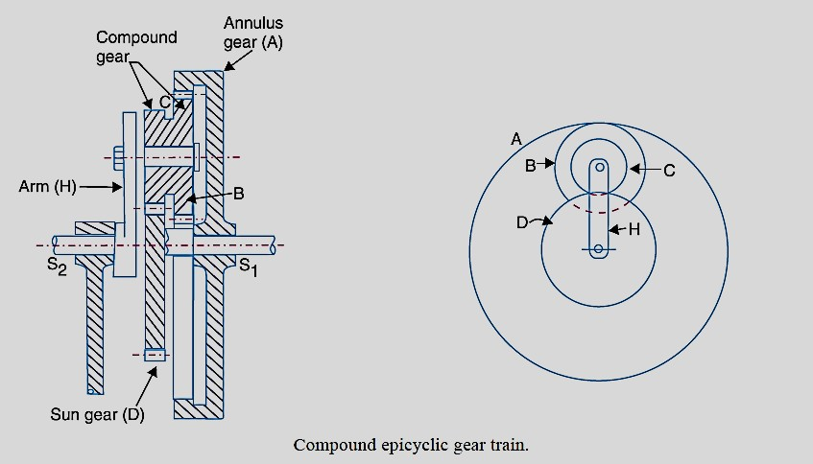
Compound Epicyclic Gear Train—Sun and Planet Gear :

Slide 47
Compound Epicyclic Gear Train—Sun and Planet Gear :
A compound epicyclic gear train is shown in Fig.
It consists of two co-axial shafts S1 and S2, an annulus gear A which is fixed, the compound gear (or planet gear) B-C, the sun gear D and the arm H. The annulus gear has internal teeth and the compound gear is carried by the arm and revolves freely on a pin of the arm H. The sun gear is co-axial with the annulus gear and the arm but independent of them.
The annulus gear A meshes with the gear B and the sun gear D meshes with the gear C. It may be noted that when the annulus gear is fixed, the sun gear provides the drive and when the sun gear is fixed, the annulus gear provides the drive. In both cases, the arm acts as a follower.

Slide 48
Note : The gear at the centre is called the sun gear and the gears whose axes move are called
planet gears.
Let TA , TB , TC , and TD be the teeth and NA, NB, NC and ND be the speeds for the gears A, B, C and D respectively. A little consideration will show that when the arm is fixed and the sun gear D is turned anticlockwise, then the compound gear B-C and the annulus gear A will rotate in the clockwise direction.

Slide 49

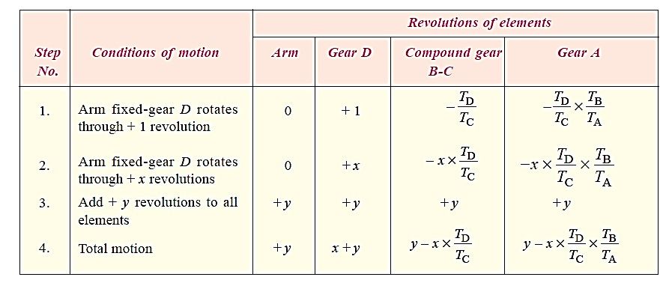
The motion of rotations of the various elements are shown in the table below.

Slide 50
In an epicyclic gear train, the internal wheels A and B and compound wheels C and D rotate independently about axis O. The wheels E and F rotate on pins fixed to the arm G. E gears with A and C and F gears with B and D. All the wheels have the same module and the number of teeth are : TC = 28; TD = 26; TE = TF = 18.
1. Sketch the arrangement ; 2. Find the number of teeth on A and B ; 3. If the arm G makes 100 r.p.m. clockwise and A is fixed,
find the speed of B ; and 4. If the arm G makes 100 r.p.m. clockwise and wheel A makes 10
r.p.m. counter clockwise ; find the speed of wheel B..

Slide 51
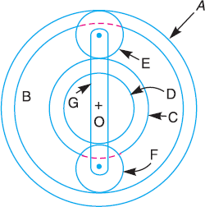
Given : TC = 28 ; TD = 26 ; TE = TF = 18
Sketch the arrangement
The arrangement is shown in Fig.
Number of teeth on wheels A and B Let TA = Number of teeth on wheel A, and TB = Number of teeth on wheel B.
If dA , dB , dC , dD , dE and dF are the pitch circle diameters of wheels A, B, C, D, E and F respectively, then from the geometry of Fig

Slide 52
dA = dC + 2 dE dB = dD + 2 dF
and
Since the number of teeth are proportional to their pitch circle diameters, for the same module, therefore TA = TC + 2 TE = 28 + 2 × 18 = 64 Ans.
and TB = TD + 2 TF = 26 + 2 × 18 = 62 Ans.
3. Speed of wheel B when arm G makes 100 r.p.m. clockwise and wheel A is fixed

Slide 53

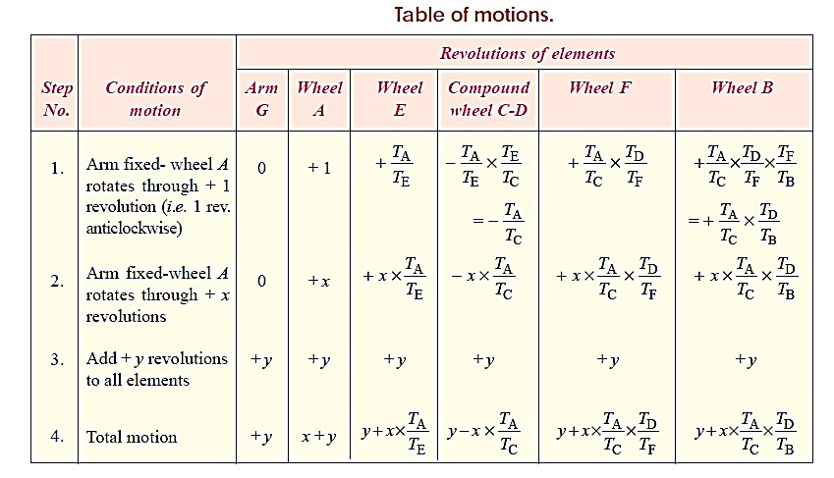

Slide 54

