Slide 1
ME8492 KINEMATICS OF MACHINERY
Cam Profile
Kalaiselvan.K
AP/MECH
Velammal Institute Of technology

Slide 2



Today’s lecture
Cam and Follower

Slide 3
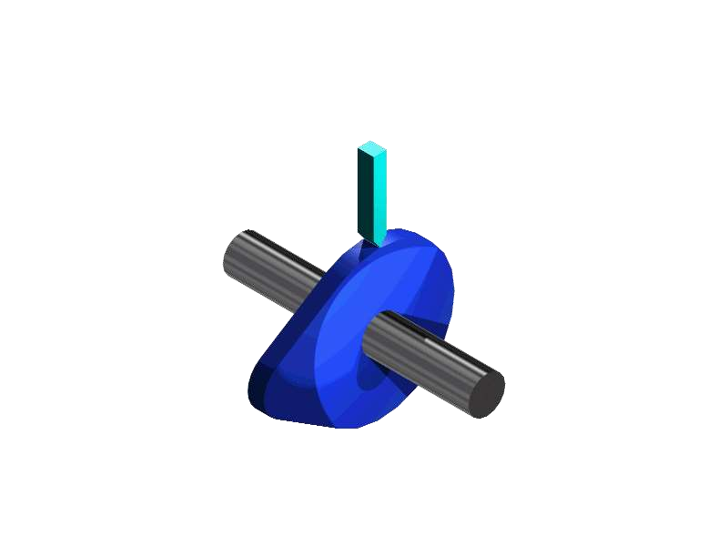
1.1 CAM - Definition
◆ Cams are used to convert rotary motion into reciprocating motion

Slide 4
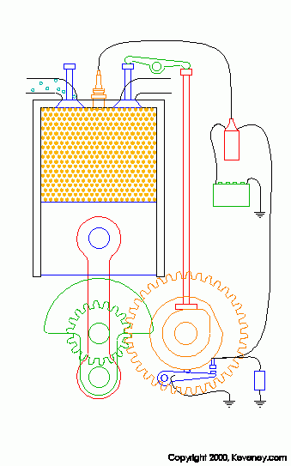
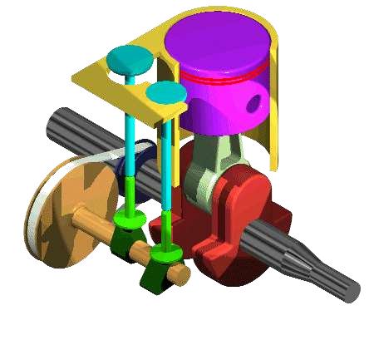
Examples for cam
◆ In IC engines to operate the inlet and exhaust valves

Slide 5
1.2 Classification of CAM Mechanism
Based on modes of Input / Output motion
    Rotating cam – Translating follower
    Rotating cam – Oscillating follower
    Translating cam – Translating follower

Slide 6
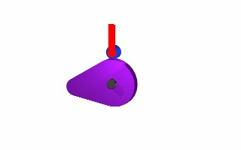
1.2.1 Rotating cam –
Translating follower

Slide 7
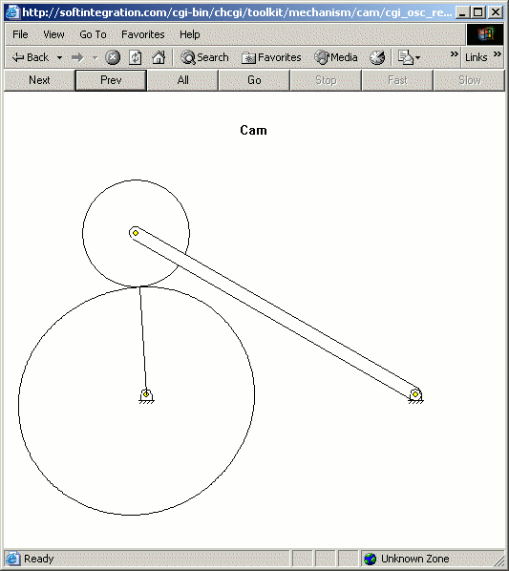
1.2.2 Rotating cam – oscillating follower

Slide 8
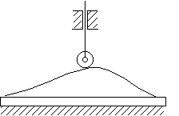
1.2.3 Translating cam –
Translating follower

Slide 9
1.3 Classification of followers
1.3.1 According to the shape of follower
◆ Knife edge follower
◆ Roller follower
◆ Flat faced follower
◆ Spherical faced follower

Slide 10
a) Knife edge follower

Slide 11
b) Roller follower

Slide 12
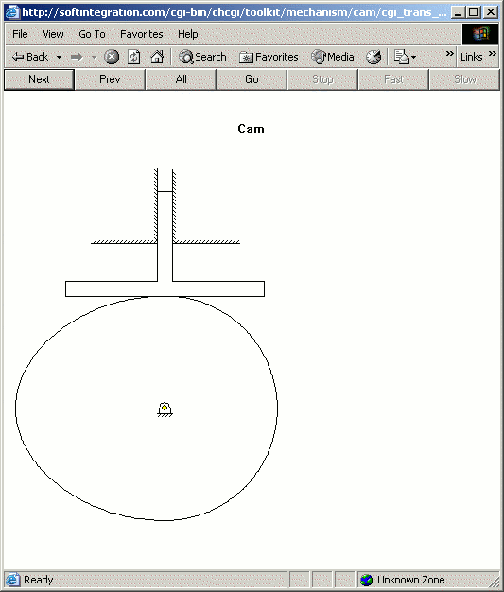
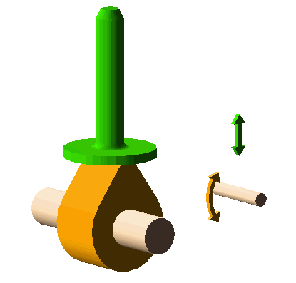
c) Flat faced follower

Slide 13
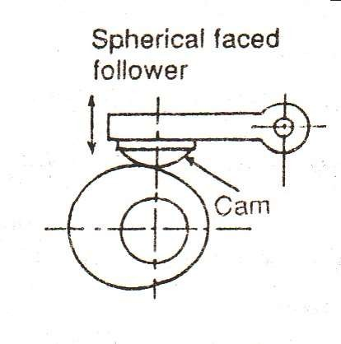
d) Spherical faced follower

Slide 14
1.3.2 According to the path of
motion of follower
Radial follower
Offset follower

Slide 15
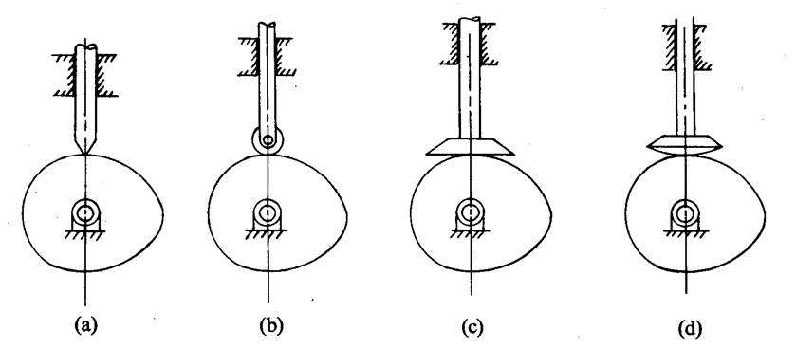
a) Radial follower
◆ When the motion of the follower is along an axis passing through the centre of the cam, it is known as radial followers. Above figures are examples of this type.

Slide 16
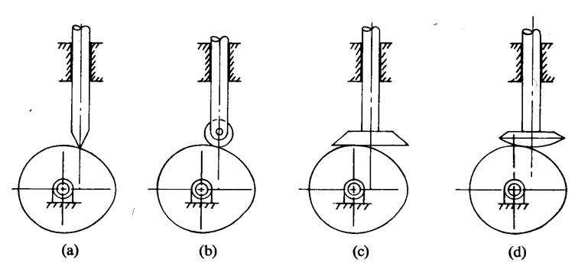
b) Offset follower
When the motion of the follower is along an axis away from the axis of the cam centre, it is called off-set follower. Above figures are examples of this type.

Slide 17
1.4 Classification of cams
Radial or disc cam
Cylindrical cam
End cam

Slide 18
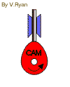
a) Radial or Disc cam
In radial cams, the follower reciprocates or oscillates in a direction perpendicular to the cam axis.

Slide 19
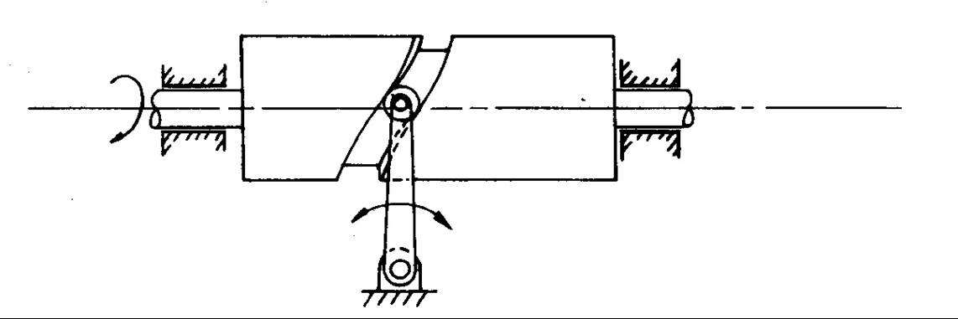
b) Cylindrical cams
In cylindrical cams, the follower reciprocates or oscillates in a direction parallel to the cams axis.

Slide 20
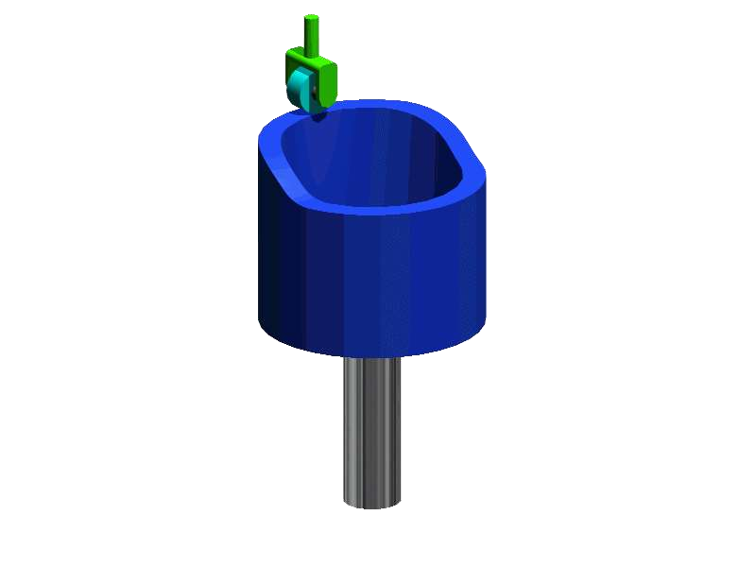
c) End cams
It is also similar to cylindrical cams, but the follower makes contact at periphery of the cam as shown in fig

Slide 21
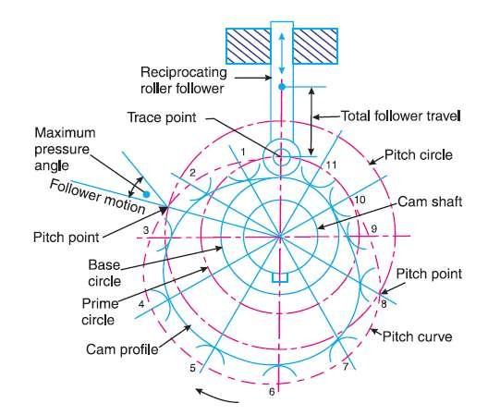
2. CAM Nomenclature
◆ Cam profile: The outer surface of the disc cam.
◆ Base circle : The circle with the shortest radius from the cam center to any part of the cam profile.
◆ Trace point: It is a point on the follower, and its motion describes the movement of the follower. It is used to generate the pitch curve.

Slide 22
2. CAM Nomenclature
◆ Pitch curve : The path generated by the trace point as the follower is rotated about a stationery cam.
Prime circle: The smallest circle from the cam center through the pitch curve

Slide 23
2. CAM Nomenclature
◆ Pressure angle: The angle between the direction of the follower movement and the normal to the pitch curve.
◆ Pitch point: Pitch point corresponds to the point of maximum pressure angle.

Slide 24
2. CAM Nomenclature
◆ Pitch circle: A circle drawn from the cam center and passes through the pitch point is called Pitch circle

Slide 25
3. Motion of the follower
As the cam rotates the follower moves upward and downward.
◆ The upward movement of follower is called rise (Outstroke)
◆ The downward movement is called fall (Returnstroke).
◆ When the follower is not moving upward and downward even when the cam rotates, it is called dwell.

Slide 26
3.1 Types of follower motion
Uniform motion ( constant velocity)
Simple harmonic motion
Uniform acceleration and retardation motion
Cycloidal motion

Slide 27
a) Uniform motion (constant velocity)
^{D}fo^{i}l^{s}lo^{p}w^{la}e^{c}r^{e}m^{m}o^{e}v^{n}e^{t}s^{d}d^{ia}u^{g}ri^{r}nªg^{m}o:n^{D}e^{is}c^{p}o^{l}m^{ac}p^{e}l^{m}ete^{n}r^{t}e^{i}v^{s}o^{t}l^{h}u^{e}tio^{d}n^{ist}(o^{an}r ^{c}c^{e}yc^{t}l^{h}eª) ^{t}oªf the cam while the follower is in contact with the cam.
◆ It is the plot of linear displacement (s) of follower V/S angular
displacement (θ) of the cam for one full rotation of the cam.
◆ A_{fol}p_{lo}e_{w}rio_{in}d_{g}i:s a part of the cam cycle and it includes the
Rise_{ca}(_{m}Ou_{m}ts_{o}t_{t}r_{i}o_{on}ke. ) – the upward motion of the follower caused by Fall_{ca}(R_{us}e_{e}tu_{d}r_{b}n_{y}s_{c}tr_{a}o_{m}ke_{m})_{o}–_{ti}t_{o}h_{n}e. downward motion of the follower Dw_{m}el_{o}l _{t}–_{io}th_{n}e. stationary position of the follower caused by cam
◆

Slide 28
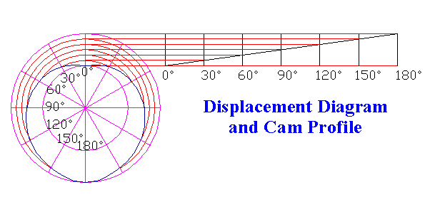
a) Uniform motion (constant
velocity)

Slide 29
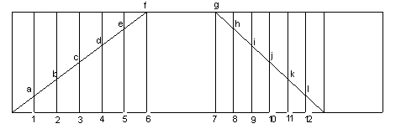
a) Uniform motion (constant velocity)
Displacement diagram
Since the follower moves with uniform velocity during its rise and fall, the slope of the displacement curve must be constant as shown in fig

Slide 30
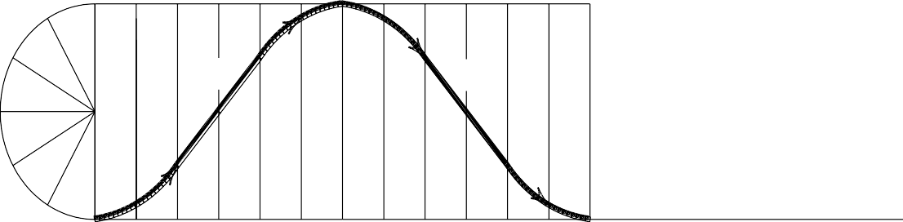
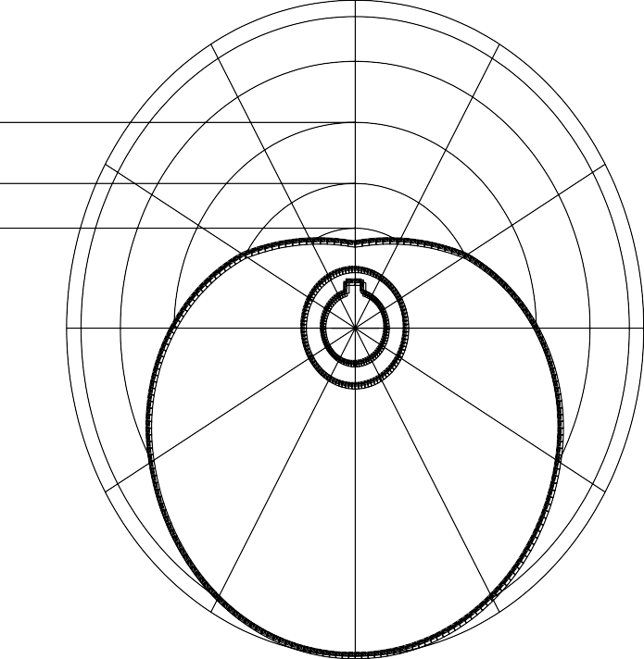
b) Simple Harmonic motion
RISE
FALL
60
120
180
240
300
360 = ONE REVOLUTION OF CAM = 1 CYCLE

Slide 31
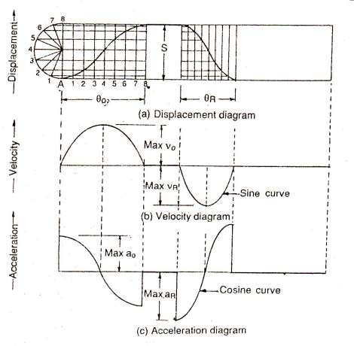
b) Simple harmonic motion
◆ Since the follower moves with a simple harmonic motion, therefore velocity diagram consists of a sine curve and the acceleration diagram consists of a cosine curve.

Slide 32
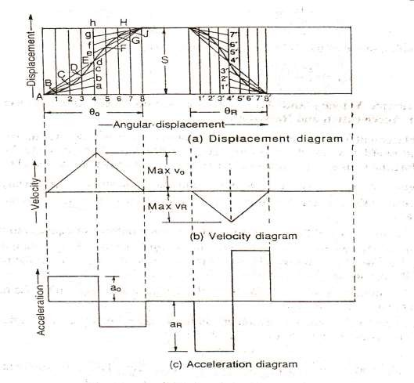
c) Uniform acceleration and retardation
◆ Since the acceleration and retardation are uniform, therefore the velocity varies directly with time.

Slide 33
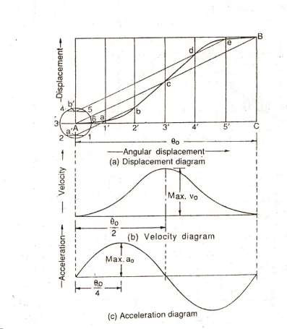
d) Cycloidal motion

Slide 34
CAM Profile
d
c
e
b
f
a
2
1
4
3
5
6
60°
45°
50
7
8
g
9
10
90°
11
12
h
l
i
j
k

