Slide 1
ME8492 KINEMATICS OF MACHINERY
Velocity and Acceleration Diagram
Kalaiselvan.K
AP/MECH
Velammal Institute Of technology

Slide 2
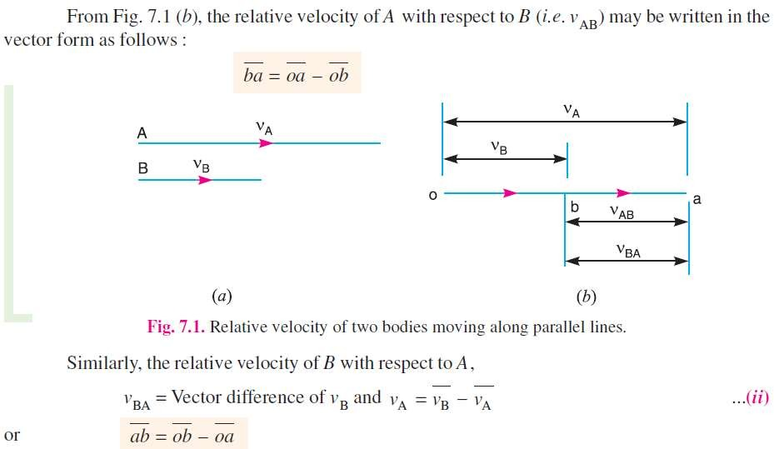
Relative Velocity of Two Bodies Moving in Straight Lines
Here we shall discuss the application of vectors for the relative velocity of two
bodies moving along parallel lines and inclined lines, as shown in Fig.
Consider two bodies A and B moving along parallel lines in the same direction with absolute velocities vA and vB such that vA > vB , as shown in Fig. (a). The relative velocity of A with respect to B is …….
2

Slide 3
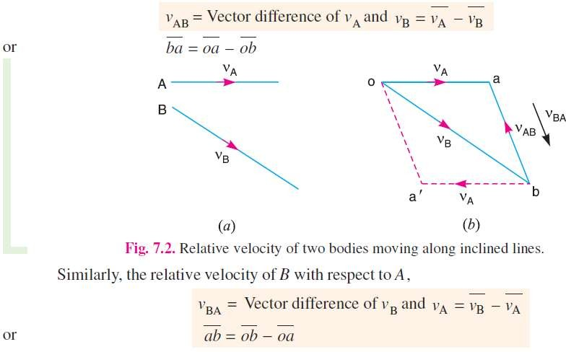
Now consider the body B moving in an inclined direction as shown in Fig. 2 (a). The relative velocity of A with respect to B may be obtained by the law of parallelogram of velocities or triangle law of velocities.
Take any fixed point o and draw vector oa to represent v_{A} in magnitude and direction to some suitable scale.
Similarly, draw vector ob to represent v_{B} in magnitude and direction to the same scale. Then vector ba represents the relative velocity of A with respect to B as shown in Fig. 2 (b). In the similar way as discussed above, the relative velocity of A with respect to B,
3

Slide 4

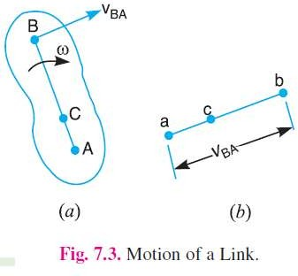
Consider two points A and B on a rigid link
AB as shown in Fig.
Let one of the extremities (B) of the link move relative to A, in a clockwise direction.
Since the distance from A to B remains the same, therefore there can be no relative motion between A and B, along the line AB.
  It is thus obvious, that the relative motion of B with respect to A
must be perpendicular to AB.
  Hence velocity of any point on a link with respect to another point on the same link is always perpendicular to the line joining these points on the configuration (or space) diagram.
4

Slide 5
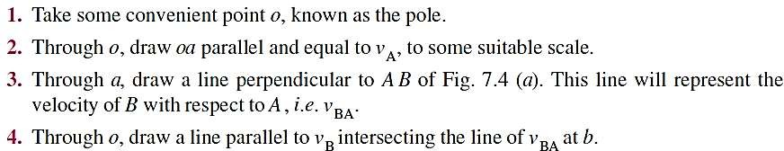
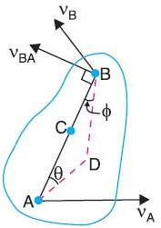
The relative velocity method is based upon the relative velocity of the various points of the
link.
Consider two points A and B on a link as shown in Fig. 4 (a).
Let the absolute velocity of the point A i.e. v_{A} is known in magnitude and direction and the absolute velocity of the point B i.e. v_{B} is known in direction only.
Then the velocity of B may be determined by drawing the velocity diagram as shown in Fig. 4
(b). The velocity diagram is drawn as follows :
b
^{V}BA
V_{B}
o
a
5
V_{A}

Slide 6
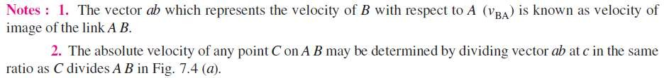
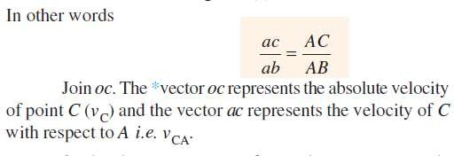
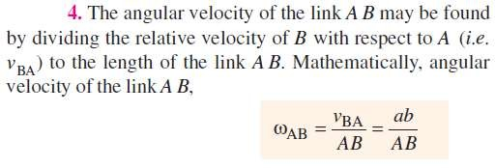
b
c
^{V}BA
V_{B}
o
a
6
V_{A}

Slide 7
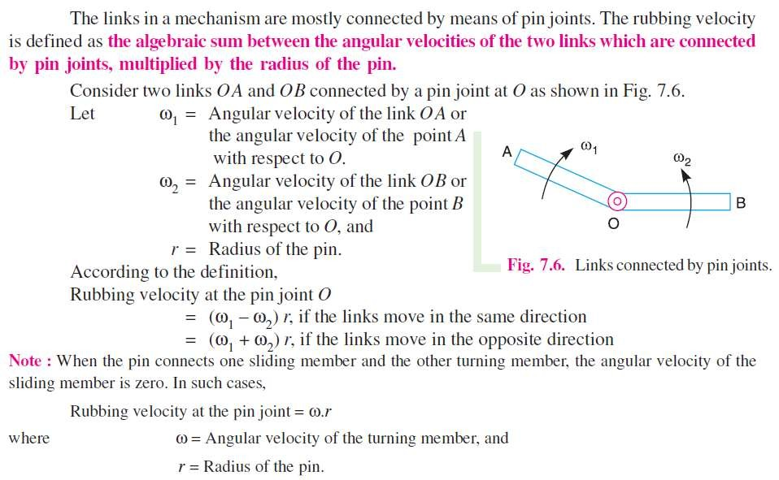
Rubbing Velocity at pin joint

Slide 8
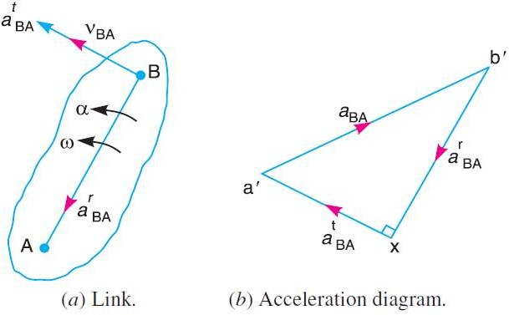


Acceleration Diagram for a Link
Consider two points A and B on a rigid link as shown in Fig.(a).
Let the point B moves with respect to A, with an angular velocity of ω rad/s and let α rad/s² be the angular acceleration of the link AB.
Acceleration of a particle whose velocity changes both in magnitude and direction
at any instant has the following two components :
  The centripetal or radial component, which is perpendicular to the velocity of the
particle at the given instant.
  The tangential component, which is parallel to the velocity of the particle at the given instant.
Thus for a link AB, the velocity of point B with respect to A (i.e. v_{BA}) is perpendicular to the link AB as shown in Fig. 8.1 (a). Since the point B moves with respect to A with an angular velocity of ω rad/s, therefore centripetal or radial component of the acceleration of B with respect to A,
This radial component of acceleration acts perpendicular to the velocity v_{BA}, In other words, it acts parallel to the link AB.

Slide 9

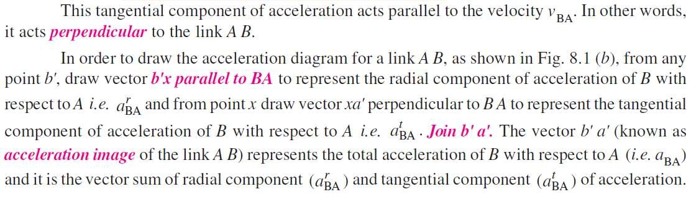

Slide 10
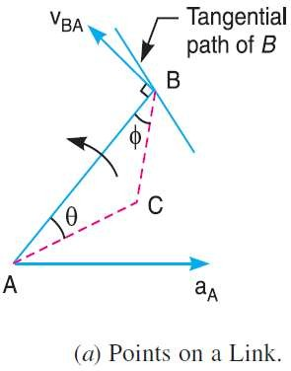
Acceleration of a Point on a Link
Consider two points A and B on the rigid link, as shown in Fig. (a). Let the acceleration of the point A i.e. a_{A} is known in magnitude and direction and the direction of path of B is given.
The acceleration of the point B is determined in magnitude and direction by
drawing the acceleration diagram as discussed below.
1. From any point o', draw vector o'a' parallel to the direction of absolute acceleration at point A i.e. a_{A} , to some suitable scale, as shown in Fig.(b).
o'
a'

Slide 11
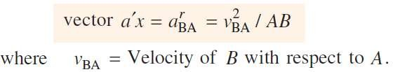
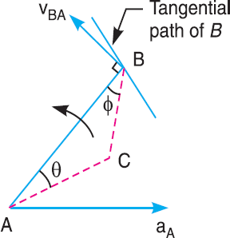
2. We know that the acceleration of B with respect to A i.e. a_{BA} has the following
two components:
Radial component of the acceleration of B with respect to A i.e. a^{r} , and
BA
Tangential component of the acceleration B with respect to A i.e. a^{t}
BA
These two components are mutually perpendicular.
3. Draw vector a'x parallel to the link AB (because radial component of the
acceleration of B with respect to A will pass through AB), such that
o'
a'
x

Slide 12
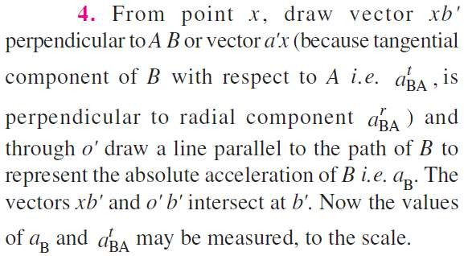

5. By joining the points a' and b' we may determine the total acceleration of B with respect to A i.e. a_{BA}. The vector a' b' is known as acceleration image of the link AB.
6. The angular acceleration of the link AB
is obtained by dividing the tangential components of the acceleration of B
b'
a
BA
with respect to A (a^{t} ) to the length
a
BA
B
of the link.
Mathematically, angular
link AB,
acceleration of the
o'
a'
^{at}BA
_{a}r
BA
x 12

Slide 13
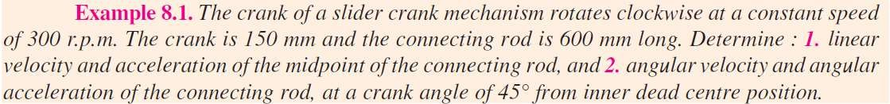
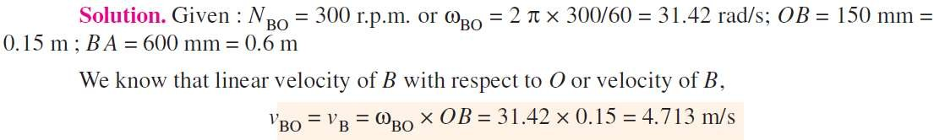
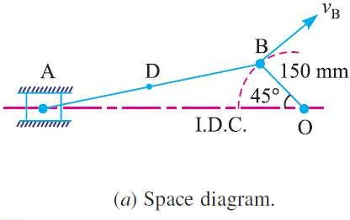
1. First of all draw the space diagram, to some suitable scale; as shown in Fig. (a).

Slide 14

To Draw Velocity Vector polygon
Draw vector ob perpendicular to BO, to some suitable scale, to represent the velocity of B with respect to O or simply velocity of B i.e. v_{BO} or v_{B}, such that vector ob = v_{BO} = v_{B} = 4.713 m/s
From point b, draw vector ba perpendicular to BA to represent the velocity of A with respect to B i.e. v_{AB} , and from point o draw vector oa parallel to the motion of A (which is along AO) to represent the velocity of A i.e. v_{A}. The vectors ba and oa intersect at a.
By measurement, we find that velocity of A with respect to B,
b
v_{B}
^{v}AB
o
a
v_{A}

Slide 15
4. In order to find the velocity of the midpoint D of the connecting rod AB, divide the
vector ba at d in the same ratio as D divides AB, in the space diagram.
In other words, bd / ba = BD/BA
Note: Since D is the midpoint of AB, therefore d is also midpoint of vector ba.
5. Join od. Now the vector od represents the velocity of the midpoint D of the connecting rod i.e. v_{D}.
By measurement, we find that v_{D} = vector od = 4.1 m/s
b
v_{B}
d
^{v}AB
v_{D}
o
a
v_{A}

Slide 16


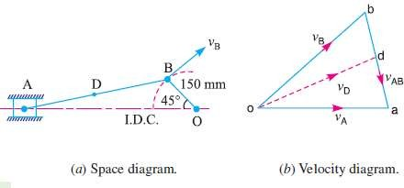
Acceleration of the midpoint of the connecting rod
We know that the radial component of the acceleration of B with respect to O or
the acceleration of B,
and the radial component of the acceleration of A with respect to B,
NOTE:1) A point at the end of a link which moves with constant angular velocity has no tangential component of acceleration.
2) When a point moves along a straight line, it has no
centripetal or radial component of the acceleration.

Slide 17
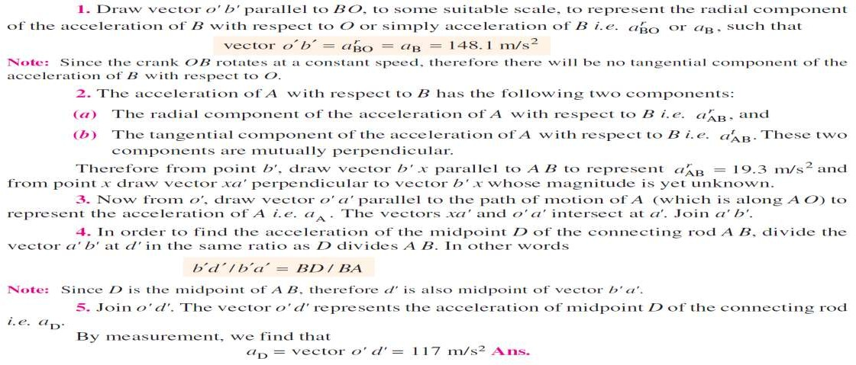
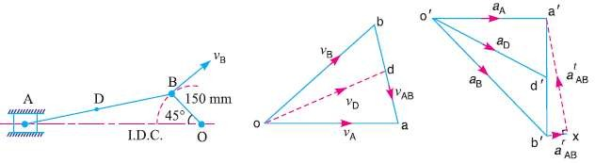
Acceleration of the midpoint of the connecting rod

Slide 18
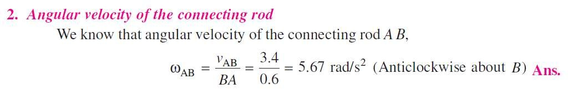
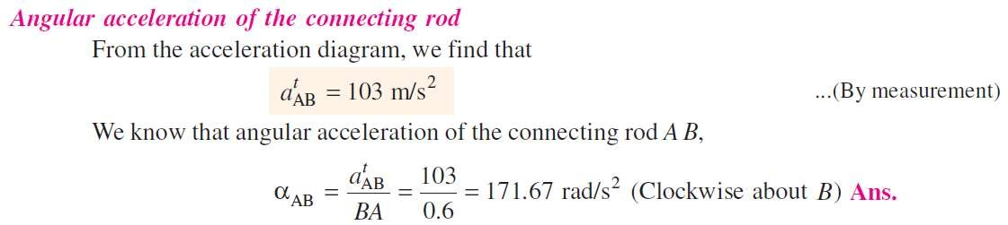
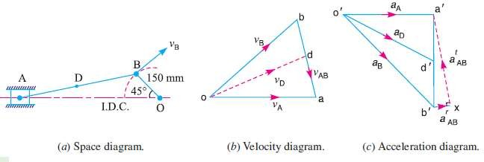

Slide 19



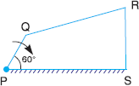

Slide 20
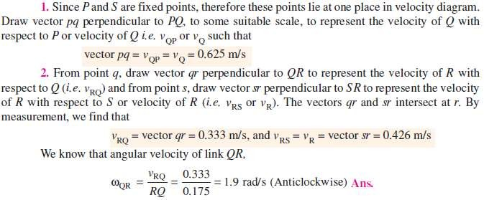



Slide 21
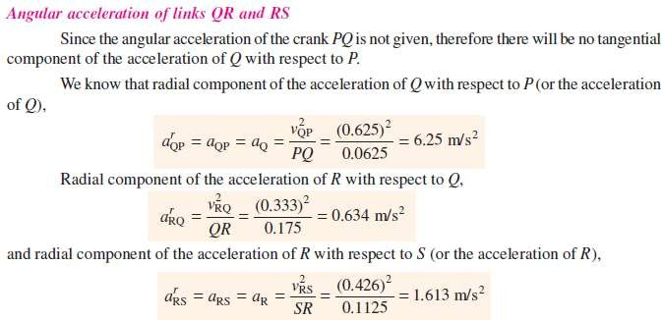
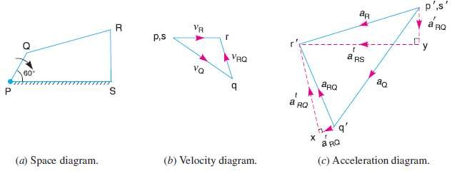

Slide 22
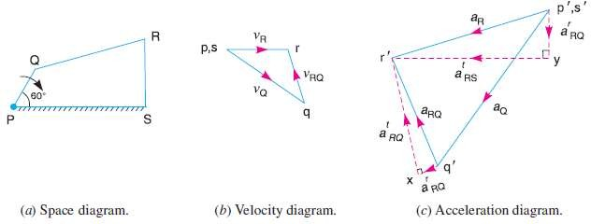
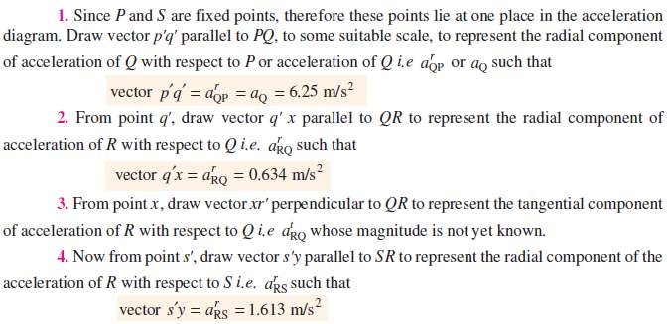

Slide 23
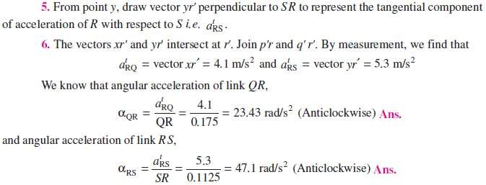

Slide 24
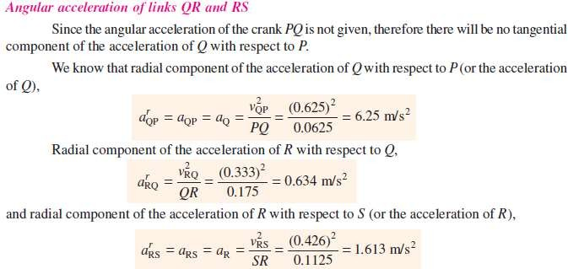
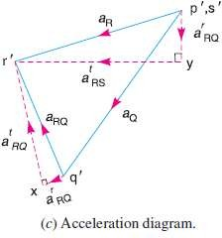

Slide 25
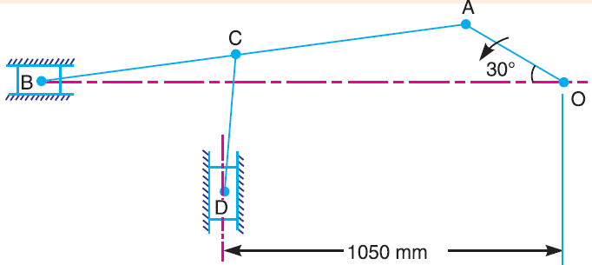

In the mechanism, as shown in Fig., the crank OA rotates at 20 r.p.m. anticlockwise and gives motion to the sliding blocks B and D. The dimensions of the various links are OA = 300 mm; AB = 1200 mm; BC = 450 mm and CD = 450 mm. For the given configuration, determine : 1. velocities of sliding at B and D, 2. angular velocity of CD, 3. linear acceleration of D and 4. angular acceleration of CD.
3/10/2016
Hareesha N G, Dept of Aero Engg, DSCE, Blore
26

Slide 26
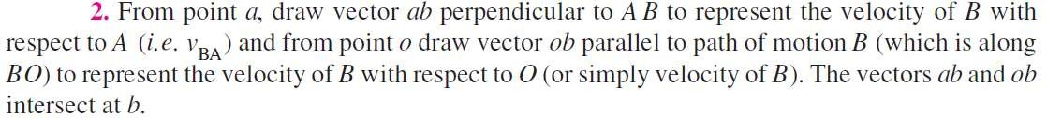
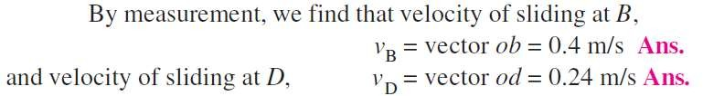
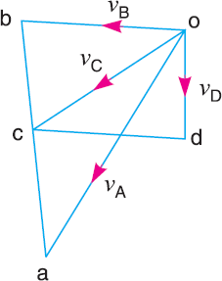


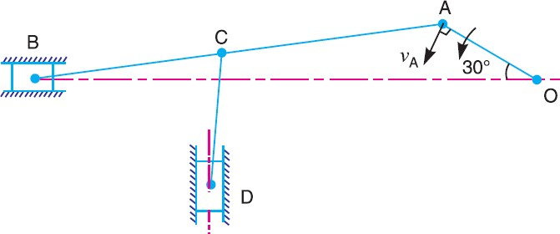


3/10/2016
Hareesha N G, Dept of Aero Engg, DSCE, Blore
27

Slide 27

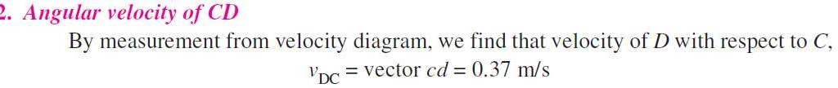
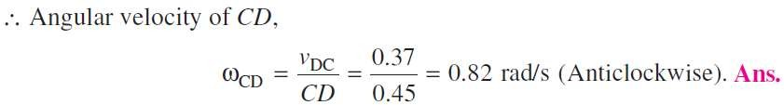
3/10/2016
Hareesha N G, Dept of Aero Engg, DSCE, Blore
28

Slide 28
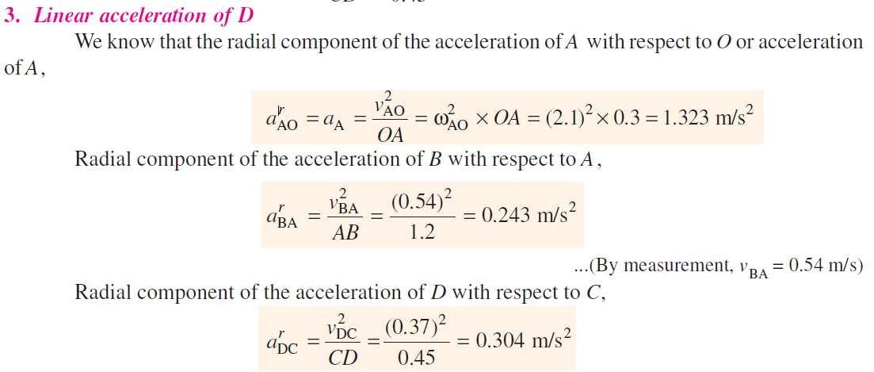
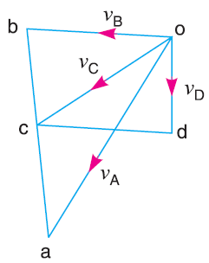


3/10/2016
Hareesha N G, Dept of Aero Engg,
DSCE, Blore
29

Slide 29
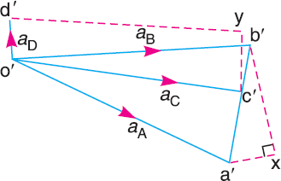

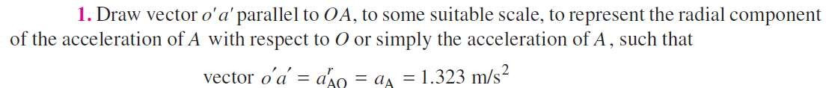
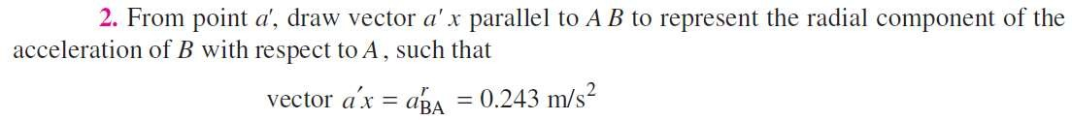
3/10/2016
Hareesha N G, Dept of Aero Engg, DSCE, Blore 30

Slide 30

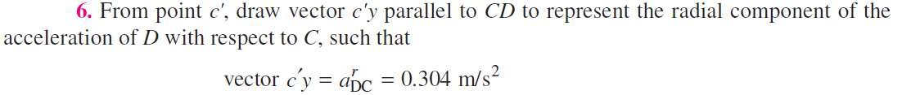
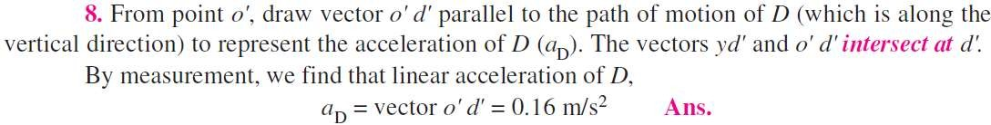
3/10/2016
Hareesha N G, Dept of Aero Engg, DSCE, Blore
30

Slide 31
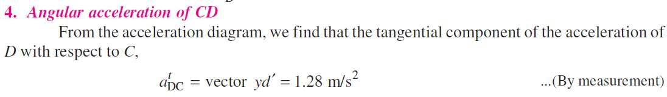
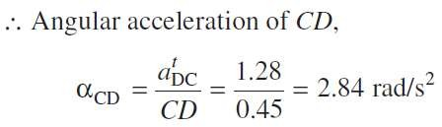
3/10/2016
Hareesha N G, Dept of Aero Engg, DSCE, Blore
31

Slide 32
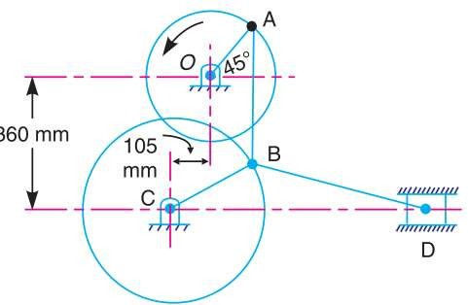

In the toggle mechanism shown in Fig., the slider D is constrained to move on a horizontal path. The crank OA is rotating in the counter-clockwise direction at a Speed of 180 r.p.m. increasing at the rate of 50 rad/s² . The dimensions of the various links are as follows: OA = 180 mm ; CB = 240 mm ; AB = 360 mm ; and BD = 540 mm. For the given configuration, find 1. Velocity of slider D and angular velocity of BD, and 2. Acceleration of slider D and angular acceleration of BD.
3/10/2016
Hareesha N G, Dept of Aero Engg, DSCE, Blore
32

Slide 33







1. Velocity of slider D and angular velocity of BD
First of all, draw the space diagram to some suitable scale, as shown in Fig. (a).
Now the velocity diagram, as shown in Fig.(b), is drawn as discussed below:
3/10/2016
Hareesha N G, Dept of Aero Engg, DSCE, Blore 34

Slide 34

3/10/2016
Hareesha N G, Dept of Aero Engg, DSCE, Blore
34

Slide 35



3/10/2016
Hareesha N G, Dept of Aero Engg, DSCE, Blore
35

Slide 36











3/10/2016
Hareesha N G, Dept of Aero Engg, DSCE, Blore
36

Slide 37



3/10/2016
Hareesha N G, Dept of Aero Engg, DSCE, Blore
37

Slide 38


3/10/2016
Hareesha N G, Dept of Aero Engg, DSCE, Blore
38

Slide 39
3/10/2016
Hareesha N G, Dept of Aero Engg, DSCE, Blore
39

Slide 40
3/10/2016
Hareesha N G, Dept of Aero Engg, DSCE, Blore
40

