Slide 1
ME8492 KINEMATICS OF MACHINERY
BASICS OF KINEMATIC MECHANISMS
Kalaiselvan.K
AP/MECH
Velammal Institute Of technology

Slide 2
Introduction:
Definitions Link or
element,
kinematic pairs,
Degrees of freedom, Grubler’s criterion (without
derivation), Structure, Machine.
Kinematic chain, Mechanism,
Mobility of Mechanism, Inversion,
Kinematic Chains and Inversions: Inversions of Four bar chain; Single slider crank chain and Double slider crank chain.

Slide 3
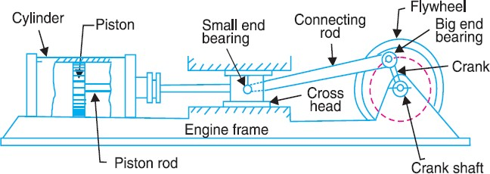
Kinematic Link or Element
Each part of a machine, which moves relative to some other part, is known as a kinematic link (or simply link) or element.
A link may consist of several parts, which are rigidly fastened together, so that they do not move relative to one another.
For example, in a reciprocating steam engine, as shown in Fig. 1, piston, piston rod and crosshead constitute one link ; connecting rod with big and small end bearings constitute a second link ; crank, crank shaft and flywheel a third link and the cylinder, engine frame and main bearings a fourth link.

Slide 4
Types of Links
In order to transmit motion, the driver and the follower may be connected by the following three types of links :
Rigid link.
A rigid link is one which does not undergo any deformation while transmitting motion. Strictly speaking, rigid links do not exist. However, as the deformation of a connecting rod, crank etc. of a reciprocating steam engine is not appreciable, they can be considered as rigid links.
Flexible link.
A flexible link is one which is partly deformed in a manner not to affect the transmission of motion. For example, belts, ropes, chains and wires are flexible links and transmit tensile forces only.
Fluid link.
A fluid link is one which is formed by having a fluid in a receptacle and the motion is transmitted through the fluid by pressure or compression only, as in the case of hydraulic presses, jacks and brakes.

Slide 5
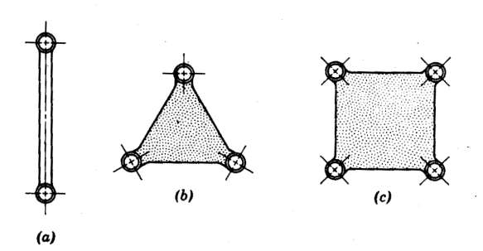
Link or element:
It is the name given to any body which has motion relative to another. All materials have some elasticity. A rigid link is one, whose deformations are so small that they can be neglected in determining the motion parameters of the link.
Binary link: Link which is connected to other links at two points. (Fig.a)
Ternary link: Link which is connected to other links at three points. (Fig.b)
Quaternary link: Link which is connected to other links at four points. (Fig. c)

Slide 6
Structure
It is an assemblage of a number of resistant bodies (known as members) having no relative motion between them and meant for carrying loads having straining action. A railway bridge, a roof truss, machine frames etc., are the examples of a structure.
Difference Between a Machine and a Structure
The following differences between a machine and a structure are important from the subject point of view :
  The parts of a machine move relative to one another, whereas the
members of a structure do not move relative to one another.
  A machine transforms the available energy into some useful work, whereas in a structure no energy is transformed into useful work.
  The links of a machine may transmit both power and motion, while
the members of a structure transmit forces only.

Slide 7
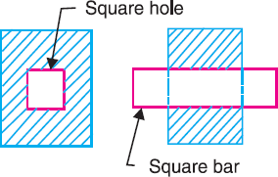
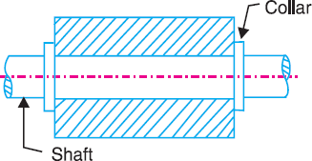
Kinematic Pair
The two links or elements of a machine, when in contact with each other, are said to form a pair. If the relative motion between them is completely or successfully constrained (i.e. in a definite direction), the pair is known as kinematic pair.
Types of Constrained Motions
Following are the three types of constrained motions :
1. Completely constrained motion.
When the motion between a pair is limited to a definite direction irrespective of the direction of force applied, then the motion is said to be a completely constrained motion.
For example, the piston and cylinder (in a steam engine) form a pair and the motion of the piston is limited to a definite direction (i.e. it will only reciprocate) relative to the cylinder irrespective of the direction of motion of the crank.
The motion of a square bar in a square hole, as shown in Fig. 2, and the motion of a shaft with collars at each end in a circular hole, as shown in Fig. 3, are also examples of completely constrained motion.

Slide 8
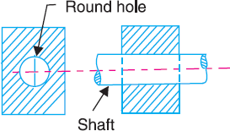
2. Incompletely constrained motion.
When the motion between a pair can take place in more than one direction, then the motion is called an incompletely constrained motion.
The change in the direction of impressed force may alter the
direction of relative motion between the pair.
A circular bar or shaft in a circular hole, as shown in Fig. 4, is an example of an incompletely constrained motion as it may either rotate or slide in a hole. These both motions have no relationship with the other.

Slide 9
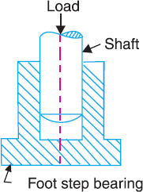
3. Successfully constrained motion
When the motion between the elements, forming a pair, is such that the constrained motion is not completed by itself, but by some other means, then the motion is said to be successfully constrained motion.
Consider a shaft in a foot-step bearing as shown in Fig. 5. The shaft may rotate in a bearing or it may move upwards. This is a case of incompletely constrained motion. But if the load is placed on the shaft to prevent axial upward movement of the shaft, then the motion of the pair is said to be successfully constrained motion.
The motion of an I.C. engine valve and the piston reciprocating inside an engine cylinder are also the examples of successfully constrained motion.

Slide 10
Link or element:
It is the name given to any body which has motion relative to another. All materials have some elasticity. A rigid link is one, whose deformations are so small that they can be neglected in determining the motion parameters of the link.
Binary link: Link which is connected to other links at two points. (Fig.a)
Ternary link: Link which is connected to other links at three points. (Fig.b)
Quaternary link: Link which is connected to other links at four points. (Fig. c)

Slide 11
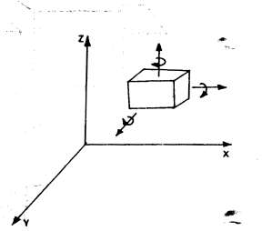
Degrees of freedom (DOF):
It is the number of independent coordinates required to describe the position of a body in space.
A free body in space (fig 1.5) can have six degrees of freedom. I.e., linear positions along x, y and z axes and rotational/angular positions with respect to x, y and z axes.
In a kinematic pair, depending on the constraints imposed on the motion, the links may loose some of the six degrees of freedom.

Slide 12
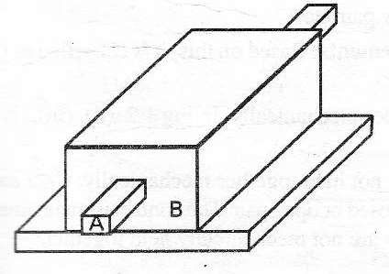
Classification of Kinematic Pairs
1. According to the type of relative motion between the elements.
(a) Sliding pair.
When the two elements of a pair are connected in such a way that one can only slide relative to the other, the pair is known as a sliding pair.
The piston and cylinder, cross-head and guides of a reciprocating steam engine, ram and its guides in shaper, tail stock on the lathe bed etc. are the examples of a sliding pair. A little consideration will show, that a sliding pair has a completely constrained motion.

Slide 13
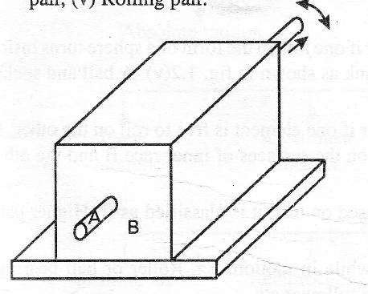
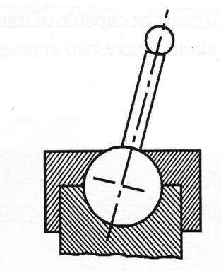
Turning pair.
When the two elements of a pair are connected in such a way that one can only turn or revolve about a fixed axis of another link, the pair is known as turning pair.
Spherical pair.
When the two elements of a pair are connected in such a way that one element (with spherical shape) turns or swivels about the other fixed element, the pair formed is called a spherical pair. The ball and socket joint, attachment of a car mirror, pen stand etc., are the examples of a spherical pair.

Slide 14
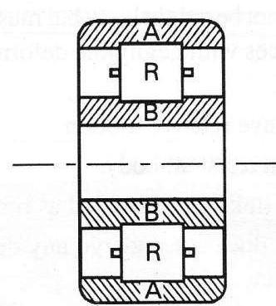
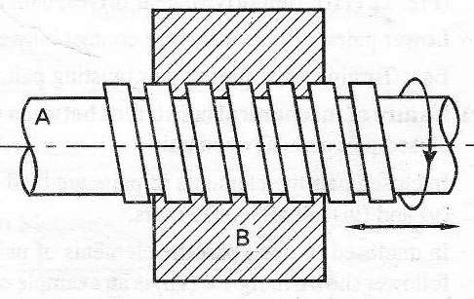
Rolling pair.
When the two elements of a pair are connected in such a way that one rolls over another fixed link, the pair is known as rolling pair. Ball and roller bearings are examples of rolling pair.
Screw pair.
When the two elements of a pair are connected in such a way that one element can turn about the other by screw threads, the pair is known as screw pair. The lead screw of a lathe with nut, and bolt with a nut are examples of a screw pair.

Slide 15
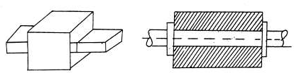
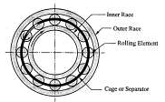
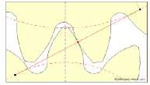
2. According to the type of contact between the elements.
Lower pair.
When the two elements of a pair have a surface contact when relative motion takes place and the surface of one element slides over the surface of the other, the pair formed is known as lower pair. It will be seen that sliding pairs, turning pairs and screw pairs form lower pairs.
Higher pair.
When the two elements of a pair have a line or point contact when relative motion takes place and the motion between the two elements is partly turning and partly sliding, then the pair is known as higher pair. A pair of friction discs, toothed gearing, belt and rope drives, ball and roller bearings and cam and follower are the examples of higher pairs.

Slide 16
3. According to the type of closure.
Self closed pair.
When the two elements of a pair are connected together mechanically in such a way that only required kind of relative motion occurs, it is then known as self closed pair. The lower pairs are self closed pair.
Force - closed pair.
When the two elements of a pair are not connected mechanically but are kept in contact by the action of external forces, the pair is said to be a force-closed pair. The cam and follower is an example of force closed pair, as it is kept in contact by the forces exerted by spring and gravity.

Slide 17
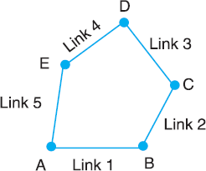
Kinematic Chain
When the kinematic pairs are coupled in such a way that the last link is joined to the first link to transmit definite motion (i.e. completely or successfully constrained motion), it is called a kinematic chain.
In other words, a kinematic chain may be defined as a combination of kinematic pairs, joined in such a way that each link forms a part of two pairs and the relative motion between the links or elements is completely or successfully constrained.

Slide 18


If each link is assumed to form two pairs with two adjacent links, then the relation between the number of pairs ( p ) forming a kinematic chain and the number of links ( l ) may be expressed in the form of an equation :
Since in a kinematic chain each link forms a part of two pairs, therefore there will be as many links as the number of pairs.
Another relation between the number of links (l) and the number of joints ( j ) which constitute a kinematic chain is given by the expression :
The equations (i) and (ii) are applicable only to kinematic chains, in which lower pairs are used.

Slide 19
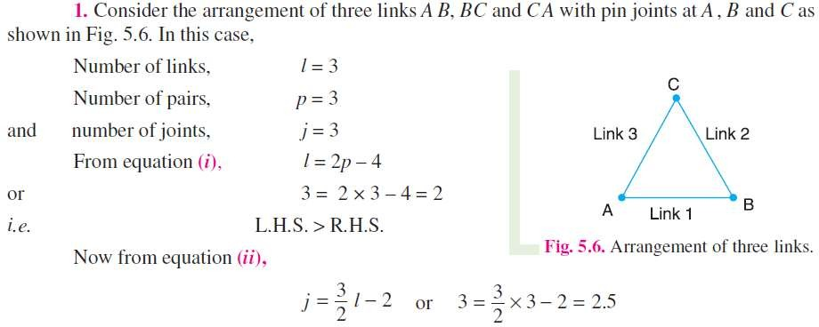
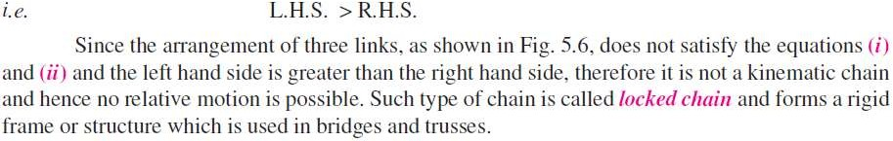

Slide 20
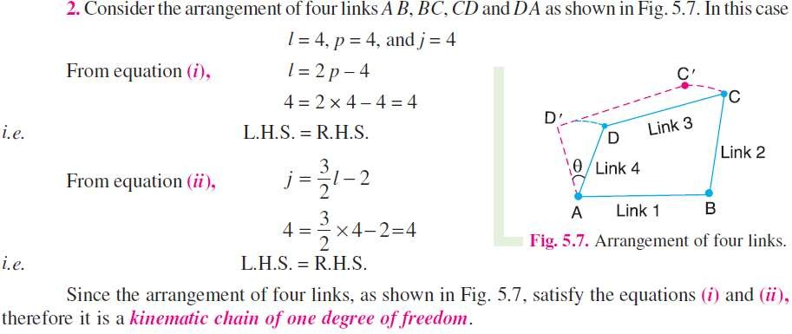

Slide 21
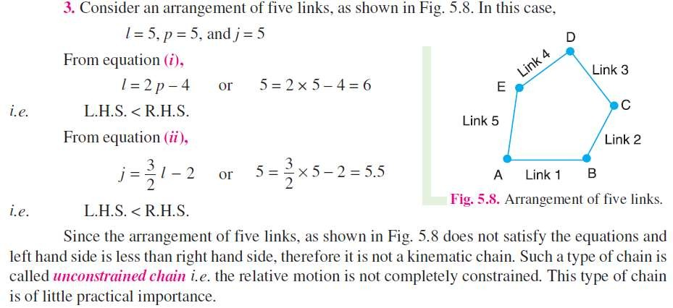

Slide 22
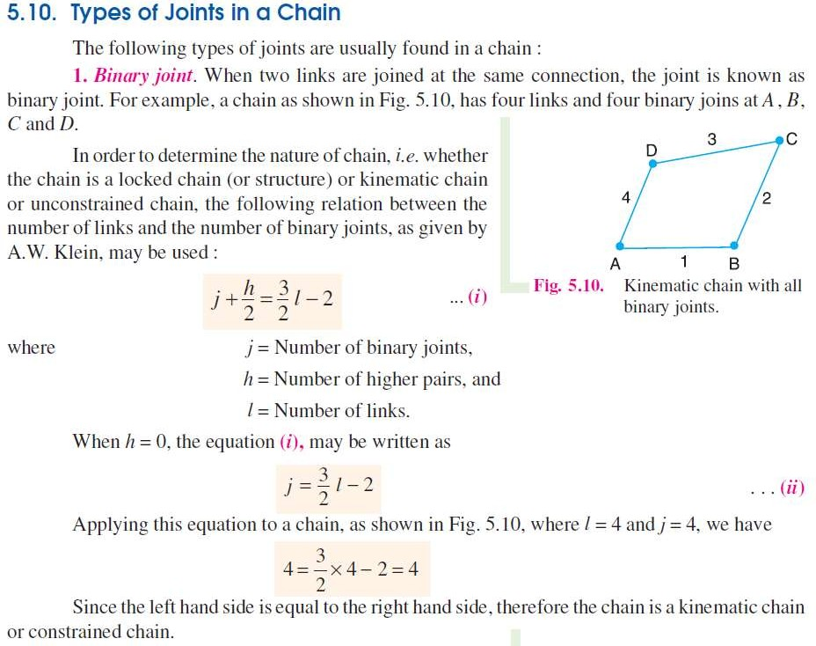

Slide 23
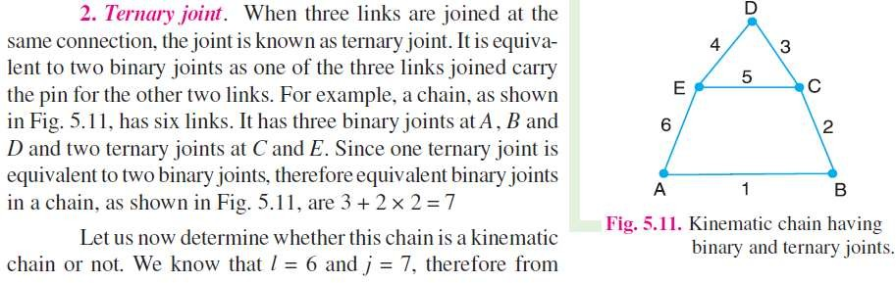
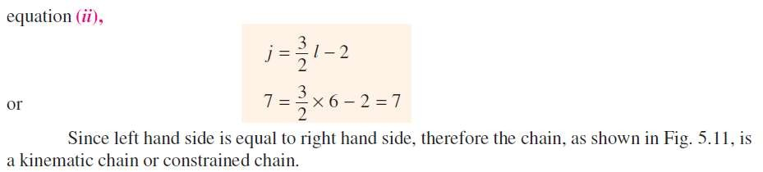

Slide 24
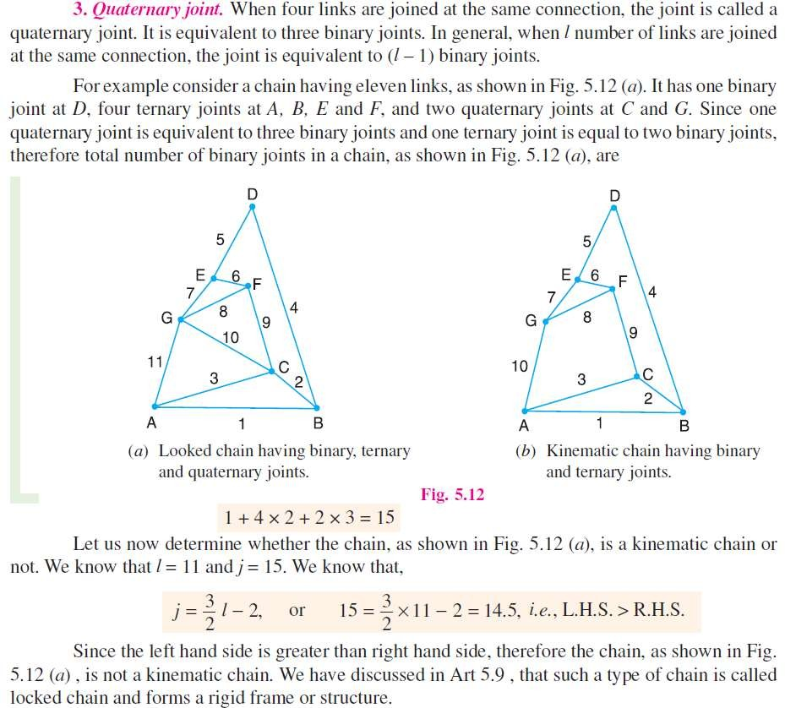

Slide 25
Mechanism
When one of the links of a kinematic chain is fixed, the chain is known as mechanism.
It may be used for transmitting or transforming motion
A mechanism with four links is known as simple mechanism, and the mechanism with more than four links is known as compound mechanism.
When a mechanism is required to transmit power or to do some particular type of work, it then becomes a machine.
In such cases, the various links or elements have to be designed to withstand the forces (both static and kinetic) safely.
A little consideration will show that a mechanism may be regarded as a machine in which each part is reduced to the simplest form to transmit the required motion.

Slide 26
Mechanisms and Simple Machines
Mechanism: the fundamental physical or chemical processes involved in or
responsible for an action, reaction or other natural phenomenon.
Machine: an assemblage of parts that transmit forces, motion and energy in a predetermined manner.
The term mechanism is applied to the combination of geometrical bodies
which constitute a machine or part of a machine.
A mechanism may therefore be defined as a combination of rigid or resistant bodies, formed and connected so that they move with definite relative motions with respect to one another .
The similarity between machines and mechanisms is that
  they are both combinations of rigid bodies
  the relative motion among the rigid bodies are definite.
The difference between machine and mechanism is that machines transform energy to do work, while mechanisms do not necessarily perform this function.
All machines are mechanisms. But all mechanisms are not machines.

Slide 27
Planar mechanisms: When all the links of a mechanism have plane motion, it is called as a planar mechanism. All the links in a planar mechanism move in planes parallel to the reference plane.
Degrees of freedom/mobility of a mechanism: It is the number of inputs (number of independent coordinates) required to describe the configuration or position of all the links of the mechanism, with respect to the fixed link at any given instant.
Grubler’s equation: Number of degrees of freedom of a mechanism is given by

Slide 28
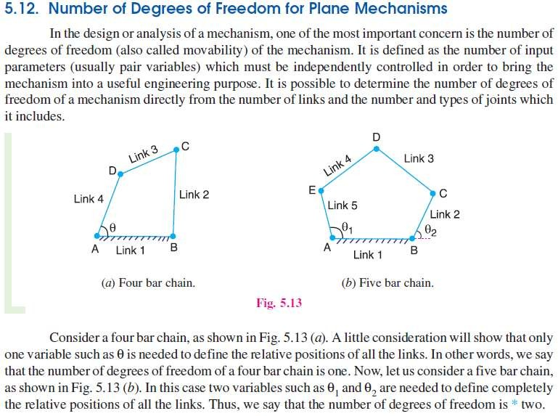

Slide 29
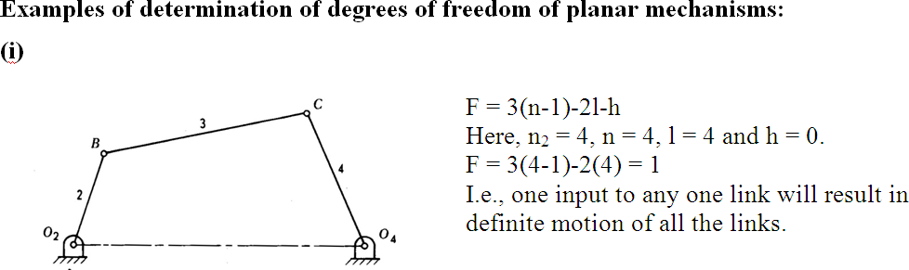
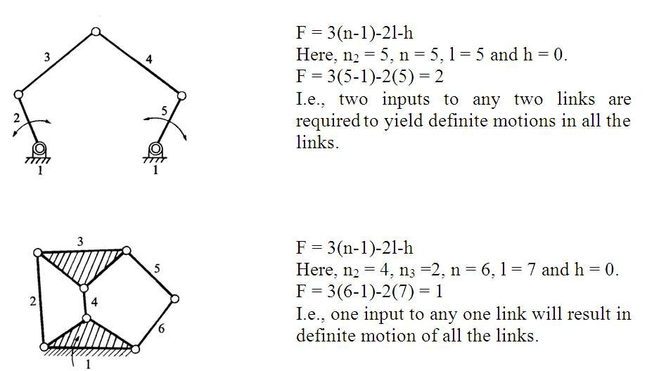

Slide 30
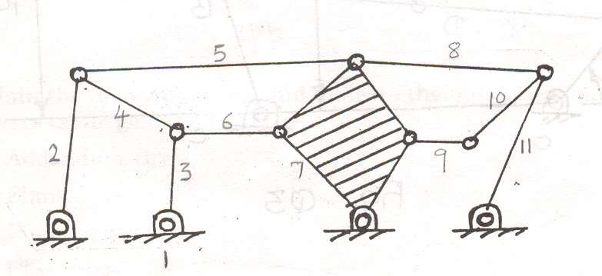
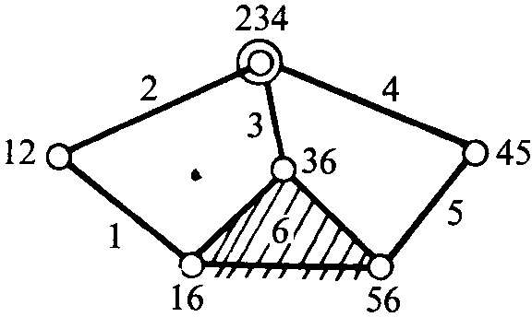
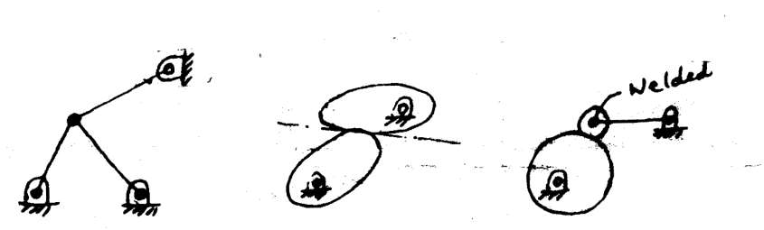
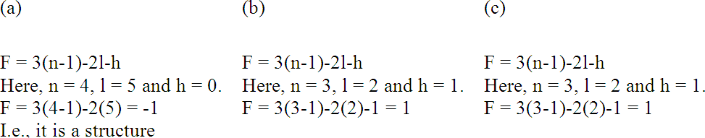

Slide 31
Types of Kinematic Chains
The most important kinematic chains are those which consist of four lower pairs, each pair being a sliding pair or a turning pair.
The following three types of kinematic chains with four lower pairs are important from the subject point of view :
  Four bar chain or quadric cyclic chain,
  Single slider crank chain, and
  Double slider crank chain.

Slide 32
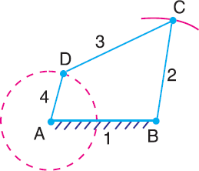
Four Bar Chain or Quadric Cycle Chain
We have already discussed that the kinematic chain is a combination of four or more kinematic pairs, such that the relative motion between the links or elements is completely constrained.
The simplest and the basic kinematic chain is a four bar chain or quadric cycle chain, as shown in Fig.
It consists of four links, each of them forms a turning pair at A, B, C and D. The four links may
be of different lengths.
A very important consideration in designing a mechanism is to ensure that the input crank makes a complete revolution relative to the other links. The mechanism in which no link makes a complete revolution will not be useful.
In a four bar chain, one of the links, in particular the shortest link, will make a complete revolution relative to the other three links. Such a link is known as crank or driver.
In Fig. AD (link 4 ) is a crank. The link BC (link 2) which makes a partial rotation or oscillates is known as lever or rocker or follower and the link CD (link 3) which connects the crank and lever is called connecting rod or coupler. The fixed link AB (link 1) is known as frame of the mechanism.
When the crank (link 4) is the driver, the mechanism is transforming rotary motion into oscillating motion.

Slide 33
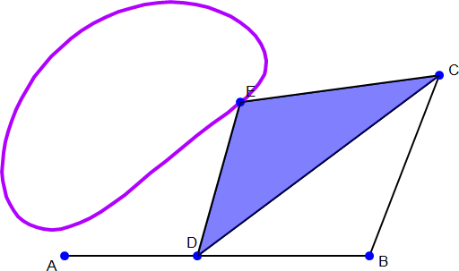

Slide 34
Inversions of mechanism:
A mechanism is one in which one of the links of a kinematic chain is fixed.
Different mechanisms can be obtained by fixing different links of the same kinematic chain.
These are called as inversions of the mechanism.
By changing the fixed link, the number of mechanisms which can be obtained is equal to the number of links.
Except the original mechanism, all other mechanisms will be known as inversions of original mechanism.
The inversion of a mechanism does not change the motion of its links relative to each other.

Slide 35
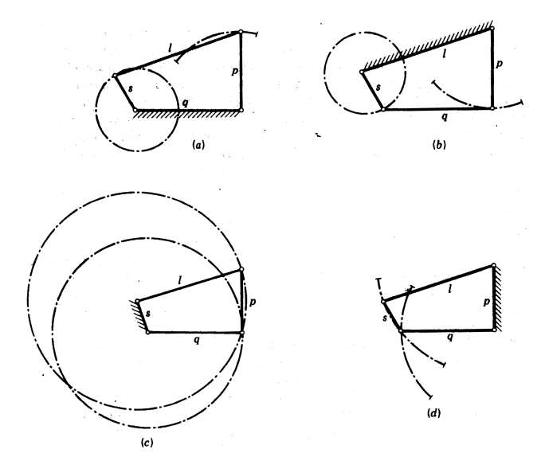
Inversions of four bar chain:

Slide 36
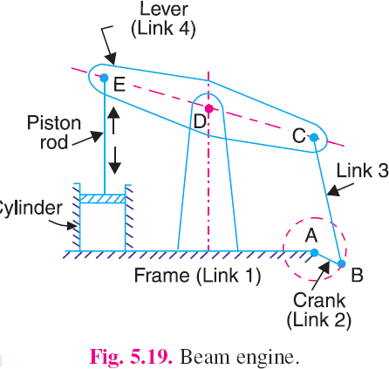
Inversions of Four Bar Chain
1. Beam engine (crank and lever mechanism).
A part of the mechanism of a beam engine (also known as crank and lever mechanism) which consists of four links, is shown in Fig.
In this mechanism, when the crank rotates about the fixed centre A,
the lever oscillates about a fixed centre D.
The end E of the lever CDE is connected to a piston rod which reciprocates due to the rotation of the crank.
In other words, the purpose of this mechanism is to convert rotary motion into reciprocating motion.

Slide 37
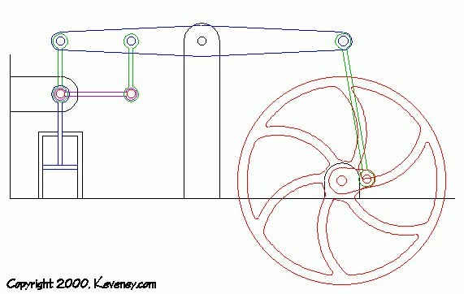

Slide 38
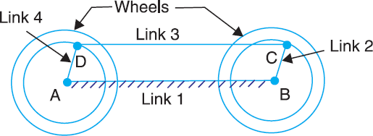
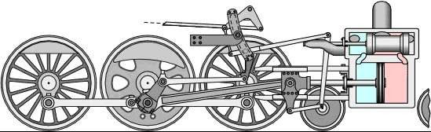
2. Coupling rod of a locomotive (Double crank mechanism).
The mechanism of a coupling rod of a locomotive (also known as double crank mechanism) which consists of four links, is shown in Fig.
In this mechanism, the links AD and BC (having equal length) act as cranks and are connected to the respective wheels.
The link CD acts as a coupling rod and the link AB is fixed in order to maintain a constant centre to centre distance between them.
This mechanism is meant for transmitting rotary motion from one wheel to the other wheel.

Slide 40
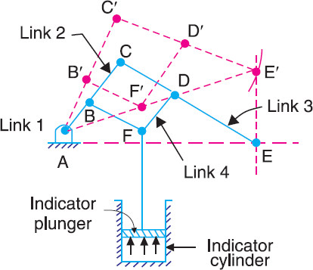
3. Watt’s indicator mechanism (Double lever mechanism).
A Watt’s indicator mechanism (also known as Watt's straight line mechanism or double lever mechanism) which consists of four links, is shown in Fig.
The four links are : fixed link at A, link AC, link CE and link BFD. It may be noted that BF and FD form one link because these two parts have no relative motion between them. The links CE and BFD act as levers.
The displacement of the link BFD is directly proportional to the pressure of gas or steam which acts on the indicator plunger.
On any small displacement of the mechanism, the tracing point E at the end of the link CE traces out approximately a straight line.
The initial position of the mechanism is shown in Fig. by full lines whereas the dotted lines show the position of the mechanism when the gas or steam pressure acts on the indicator plunger.

Slide 41
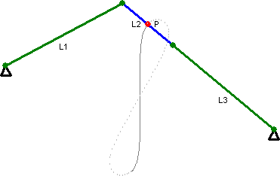

Slide 42
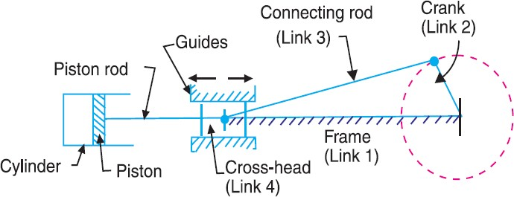
Single Slider Crank Chain
A single slider crank chain is a modification of the basic four bar chain.
It consist of one sliding pair and three turning pairs. It is, usually, found in reciprocating steam engine mechanism.
This type of mechanism converts rotary motion into reciprocating motion and vice versa.
In a single slider crank chain, as shown in Fig., the links 1 and 2, links 2 and 3, and links 3
and 4 form three turning pairs while the links 4 and 1 form a sliding pair.
The link 1 corresponds to the frame of the engine, which is fixed. The link 2 corresponds to the crank ; link 3 corresponds to the connecting rod and link 4 corresponds to cross- head.
As the crank rotates, the cross-head reciprocates in the guides and thus the piston reciprocates in the cylinder.

Slide 43


Slide 44
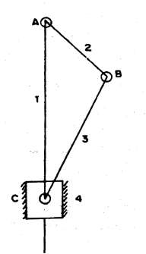
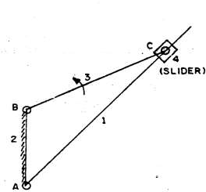
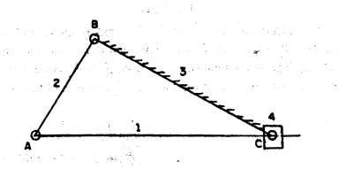
Inversions of Single Slider Crank Chain
Four inversions of a single slider crank chain are possible.
These inversions are found in the following mechanisms.
Pendulum pump or Bull engine.
Oscillating cylinder engine
Rotary internal combustion engine
Crank and slotted lever quick return motion mechanism.
Whitworth quick return motion mechanism.
(b) connecting rod fixed
(a) crank fixed
(c) slider fixed
44

Slide 45
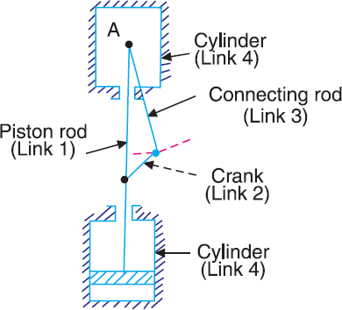
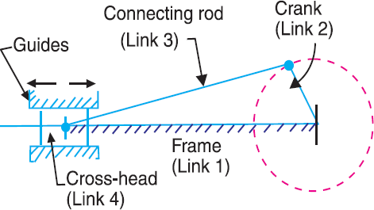
Pendulum pump or Bull engine.
In this mechanism, the inversion is obtained by fixing the cylinder or link 4 (i.e. sliding pair), as shown in Fig.
In this case, when the crank (link 2) rotates, the connecting rod (link 3) oscillates about a pin pivoted to the fixed link 4 at A and the piston attached to the piston rod (link 1) reciprocates.
The duplex pump which is used to supply feed water to boilers have two pistons attached to link 1, as shown in Fig.

Slide 46
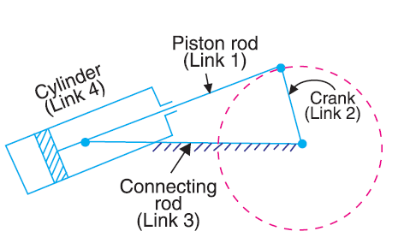
Oscillating cylinder engine
The arrangement of oscillating cylinder engine mechanism, as shown in Fig., is used to convert reciprocating motion into rotary motion.
In this mechanism, the link 3 forming the turning pair is fixed. The link 3 corresponds to the connecting rod of a reciprocating steam engine mechanism.
When the crank (link 2) rotates, the piston attached to piston rod (link 1) reciprocates and the cylinder (link 4) oscillates about a pin pivoted to the fixed link at A.

Slide 47
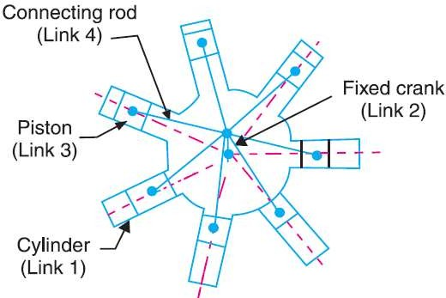
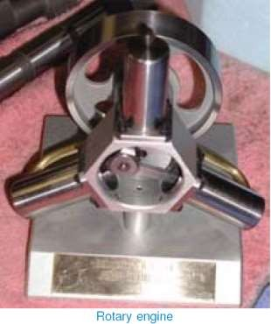
Rotary internal combustion engine
Sometimes back, rotary internal combustion engines were used in aviation. But now-a-days gas turbines are used in its place.
It consists of seven cylinders in one plane and all revolves about fixed centre D, as shown in Fig., while the crank (link 2) is fixed.
In this mechanism, when the connecting rod (link 4) rotates, the piston (link 3) reciprocates inside the cylinders forming link 1.

Slide 48
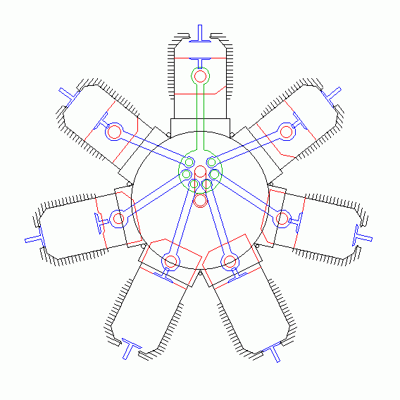

Slide 49
Inversions of double slider crank mechanism
Elliptical trammels
Scotch yoke mechanism
Oldham’s coupling

Slide 50


1. Elliptical trammels.
It is an instrument used for drawing ellipses. This inversion is obtained by fixing the slotted plate (link 4), as shown in Fig.
The fixed plate or link 4 has two straight grooves cut in it, at right angles to each other.
The link 1 and link 3, are known as sliders and form sliding pairs with link 4. The link
AB (link 2) is a bar which forms turning pair with links 1 and 3.
When the links 1 and 3 slide along their respective grooves, any point on the link 2 such as P traces out an ellipse on the surface of link 4, as shown in Fig. A little consideration will show that AP and BP are the semi-major axis and semi-minor axis of the ellipse respectively.

Slide 51



Slide 52


2. Scotch yoke mechanism.
The Scotch yoke is a mechanism for converting the linear motion of a slider into rotational motion or vice-versa. The piston or other reciprocating part is directly coupled to a sliding yoke with a slot that engages a pin on the rotating part.
This mechanism is used for converting rotary motion into a reciprocating motion. The inversion is obtained by fixing either the link 1 or link 3. In Fig. link 1 is fixed.
In this mechanism, when the link 2 (which corresponds to crank) rotates about B as centre, the link 4 (which corresponds to a frame) reciprocates.
The fixed link 1 guides the frame.

Slide 53

3. Oldham’s coupling.
An oldham's coupling is used for connecting two parallel shafts whose axes are at a small distance apart. The shafts are coupled in such a way that if one shaft rotates, the other shaft also rotates at the same speed.
This inversion is obtained by fixing the link 2, as shown in Fig (a).
The shafts to be connected have two flanges (link 1 and link 3) rigidly fastened at their ends by forging.
The link 1 and link 3 form turning pairs with link 2.
These flanges have diametrical slots cut in their inner faces, as shown in Fig.(b).
The intermediate piece (link 4) which is a circular disc, have two tongues (i.e. diametrical projections) T1 and T2 on each face at right angles to each other, as shown in Fig. 5.36 (c).
The tongues on the link 4 closely fit into the slots in the two flanges (link 1 and link
3). The link 4 can slide or reciprocate in the slots in the flanges.

