Slide 1
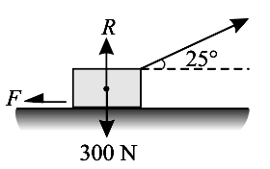
UNIT – 2
PART – A
1. State the laws of dry (coulomb) friction
•
The frictional force always acts in a direction opposite to that in which the body tends
to move.
•
The force of friction is equal to force applied to the body as long as the body is at
rest.
•
•
The force of friction depends upon the nature of surfaces in contact.
The frictional force does not depend on the area and shape of surfaces in contact.
2. Define coefficient of kinetic friction.
When the bodies are in relative motion the co-efficient of friction is called kinetic. The kinetic
co-efficient of friction is always less than static co-efficient of friction
3. What is coulomb friction
The friction that exists between two unlubricated surfaces is called coulomb friction.
4. Define coefficient of static friction
It is defined as the ratio of limiting forceof friction (F) to the normal reaction it is denoted by
µ.
µ = limiting force of friction/ normal force = F/N
5. List out the different types of friction.
The different types of friction are:
Dry friction and Fluid friction
Co-efficient of static friction is given by,
µ = F/R
6. Define angle of repose
It is defined as the maximum inclination of a plane at which the body remains in equilibrium,
over the inclined plane by the assistance of friction only.
7. Define the rolling resistance.
Rolling resistance is the resistance to the motion of the roller moving without slipping on a
horizontal surface while supporting a load ‘W’ at the center.
8. A body of weight 300 N is lying on a rough horizontal plane having a coefficient of
friction as 0.3. Find the magnitude of the force, which can move the body, while
acting at an angle of 25 ° with the horizontal.
Force of friction F = P cos α = P cos 25° = P × 0.9063 N
Reaction of friction R = W – P sin α = 300 – P sin 25° = 300 – P × 0.4226
0.9063 P = µR = 0.3 × (300 – 0.4226 P) = 90 – 0.1268 P
P = 87.1 N
9. What is a couple?
The turning effect produced by two equal and opposite force separated by a distance
constitute a couple.
10. Write the conditions for equilibrium for a rigid body in space.

Slide 2
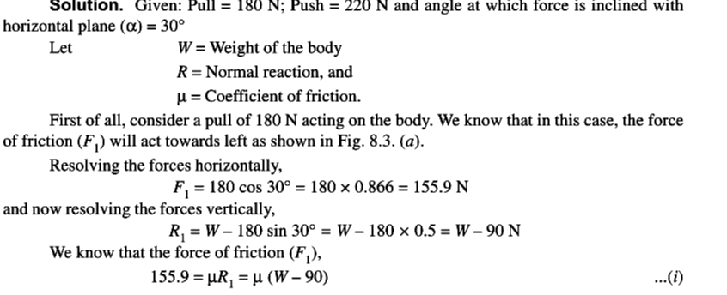
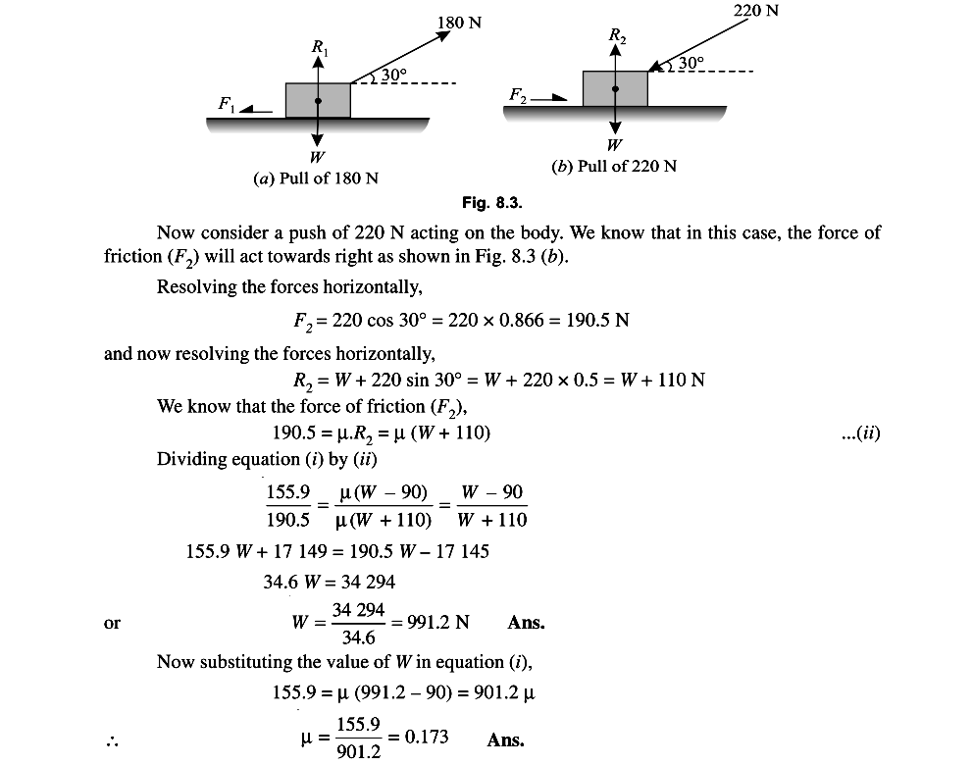
Algebraic sum of in x, y and z direction individually is zero, algebraic sum of moments is
zero.
PART – B
1. A body, resting on a rough horizontal plane, required a pull of 180 N inclined at 30° to the
plane just to move it. It was found that a push of 220 N inclined at 30° to the plane just
moved the body. Determine the weight of the body and the coefficient of friction.

Slide 3
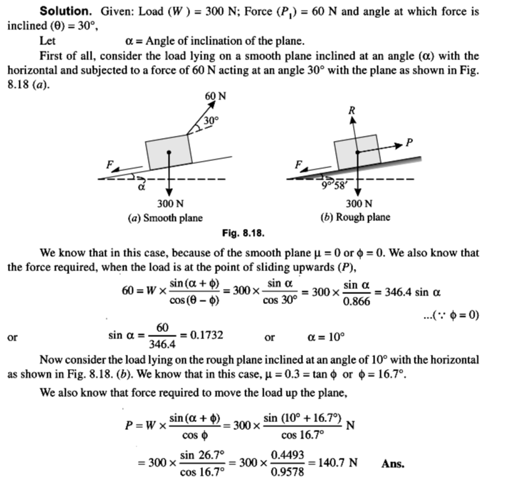
2. Find the force required to move a load of 300 N up a rough plane, the force being applied
parallel to the plane. The inclination of the plane is such that when the same load is kept on
a perfectly smooth plane inclined at the same angle, a force of 60 N applied at an
inclination of 30° to the plane, keeps the same load in equilibrium. Assume coefficient of
friction between the rough plane and the load to be equal to 0.3.

Slide 4
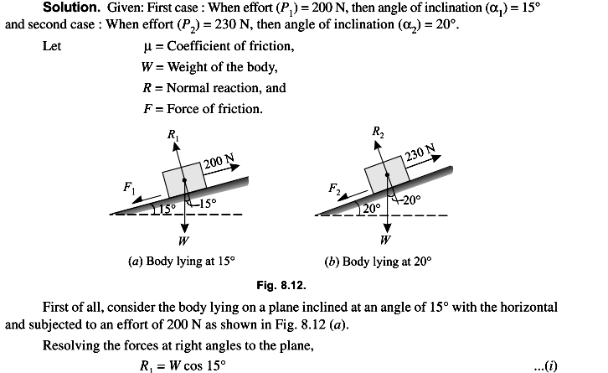
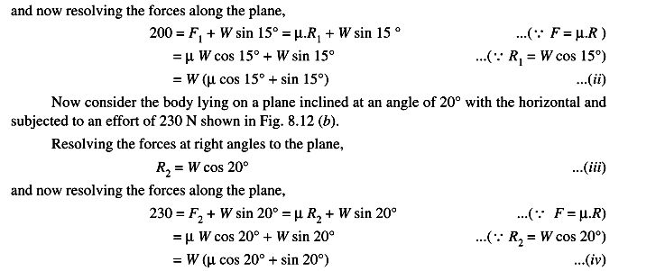
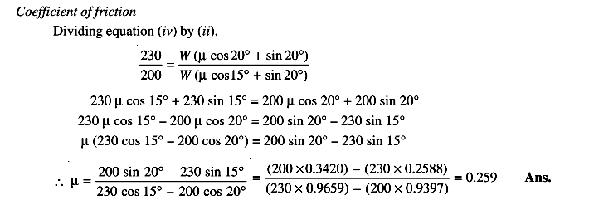
3. An effort of 200 N is required just to move a certain body up an inclined plane of angle 15°
the force acting parallel to the plane. If the angle of inclination of the plane is made 20° the
effort required, again applied parallel to the plane, is found to be 230 N. Find the weight of
the body and the coefficient of friction.

Slide 5
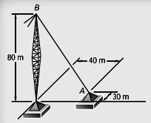
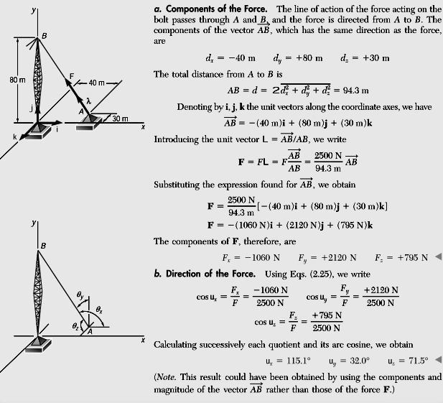
4. A tower guy wire is anchored by means of a bolt at A. The tension in the wire is 2500 N.
Determine (a) the components Fx , Fy , Fz of the force acting on the bolt, (b) the angles ux ,
uy , uz defining the direction of the force.
Solution

Slide 6
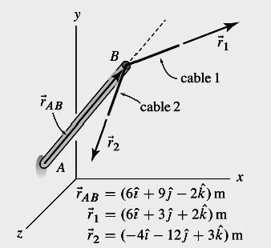
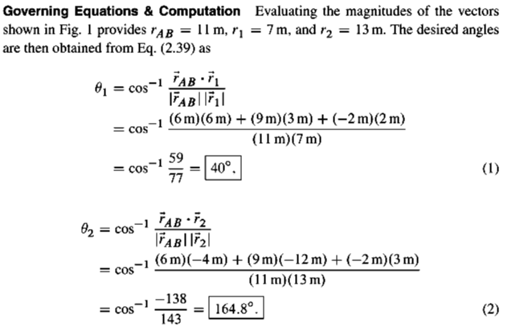
5, Bar AB supports two cables at its end. The position vector from A to B is rAB , the position
vector from B to some point along the length of cable 1 is r1 , and the position vector from B
to some point along the length of cable 2 is r2 . Determine the angles between bar AB and
the cables.
Solution

Slide 7
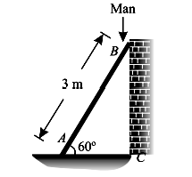
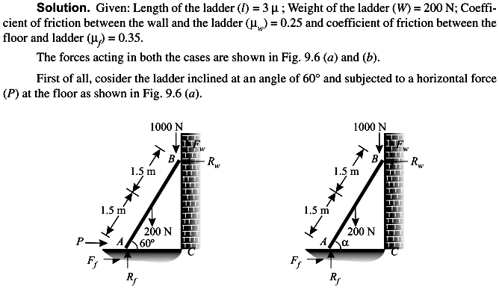
PART C
1. A uniform ladder 3 m long weighs 200 N. It is placed against a wall making an angle of 60°
with the floor as shown in Fig below
The coefficient of friction between the wall and the ladder is 0.25 and that between the floor
and ladder is 0.35. The ladder, in addition to its own weight, has to support a man of 1000
N at its top at B. Calculate: (i) The horizontal force P to be applied to ladder at the floor level
to prevent slipping . (ii) If the force P is not applied, what should be the minimum inclination
of the ladder with the horizontal, so that there is no slipping of it with the man at its top.

Slide 8
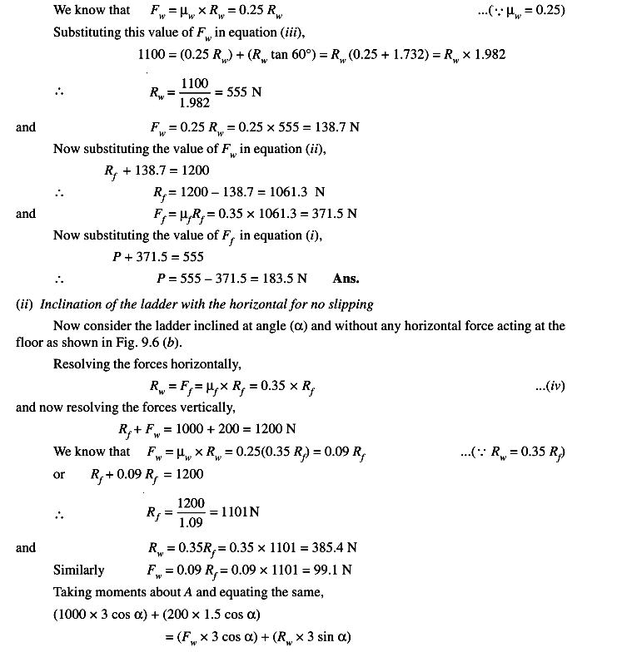

Slide 9
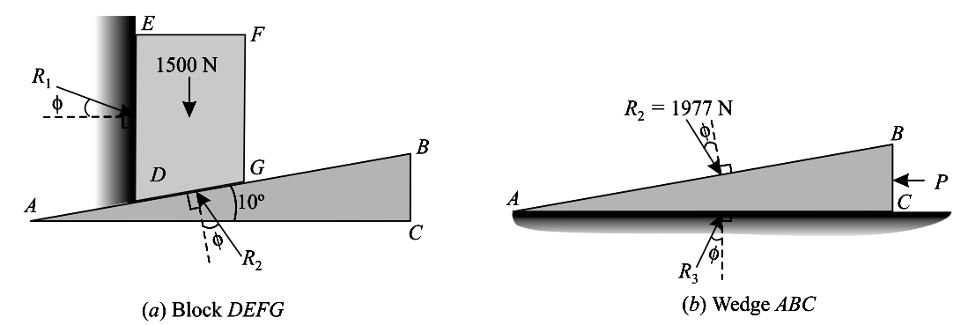
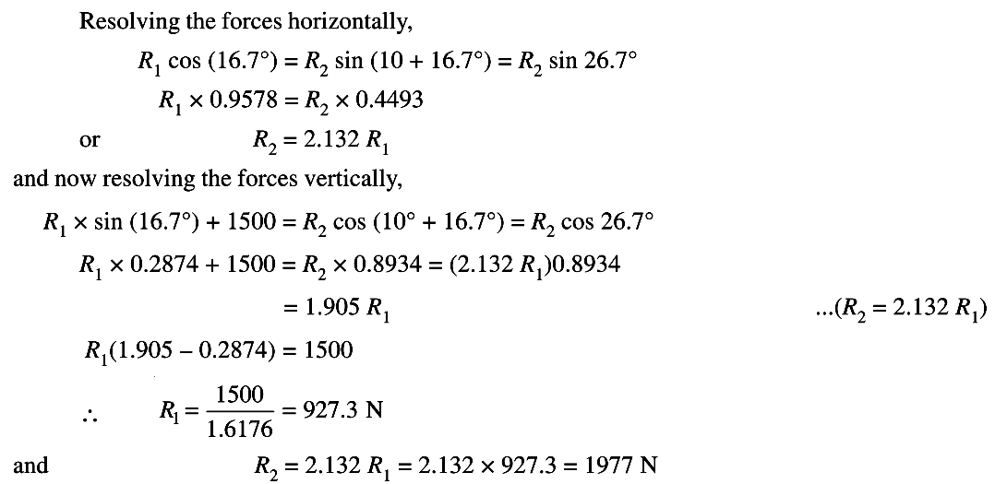
2. A block weighing 1500 N, overlying a 10° wedge on a horizontal floor and leaning against a
vertical wall, is to be raised by applying a horizontal force to the wedge. Assuming the
coefficient of friction between all the surface in contact to be 0.3, determine the minimum
horizontal force required to raise the block.
Solution. Given: Weight of the block (W) = 1500 N; Angle of the wedge (α) = 10° and
coefficient of friction between all the four surfaces of contact (µ) = 0.3 = tan φ or φ =
16.7°.

Slide 10
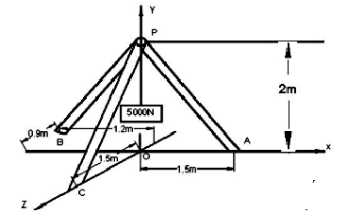
3. For the tripod shown in figure below, the end points are in ZX plane. A body of weight
5000N is suspended from point P. find the force in each leg.
Given data:
W= 5000 N
From the diagram the co coordinates of A,B,C and P are A(1.5,0,0); B(0,0,1.5); C(-1.2,0,-
0.9); P(0,2,0)
To find
Force on each leg (T1 , T2 , T3 & T4 )
Direction vector along AP = -1.5i+2j
Unit vector along AP = (-1.5i+2j)/2.5
Let force vector along AP be T1 = T1 (-1.5i+2j)/2.5
Similarly
Let force vector along BP be T2 = T2 (2j-1.5k)/2.5
Let force vector along CP be T3 = T3 (1.2i+2j+0.9k)/2.5
Let the load be T4 = -5000j.
For equilibrium T1 +T2 +T3 +T4 = 0
By solving the above condition
We get T1 =2083.4N; T2 =1562.5N; T3 =2604.2N

Slide 11
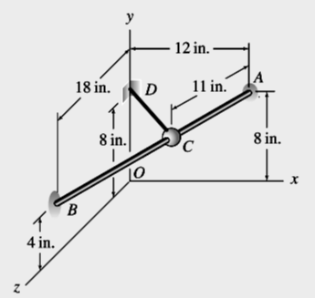
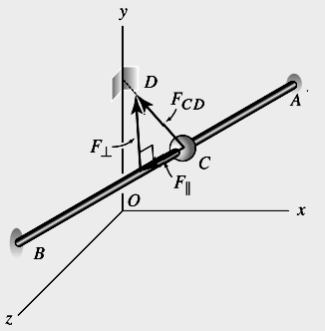
4. Rod AB is straight and has a bead at C . An elastic cord having a 3 lb tensile force is
attached between the bead and a support at D. (a) Determine the components of the cord
force in directions parallel and perpendicular to rod AB. (b) Determine the vector
components of the cord force in directions parallel and perpendicular to rod AB. (c) If the
bead at C is free to slide on rod AB and is released from rest, will the cord force tend to
make the bead slide toward A or B?
Solution
The position vector from A to B, and its magnitude
The position vector from A to C has 11 in: magnitude and has the same direction as rAB
The position vector from C to D, rCD

Slide 12
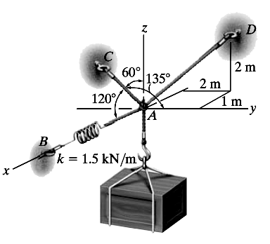
The cord force, which is shown in Fig above
The component of the cord force EFCD in direction A to B as F||
Vector form of parallel force
The magnitude of the perpendicular component
of the cord force, the Pythagorean
theorem
Vector form of perpendicular force
5. Determine the tension in each cord used to support the 100-kg crate shown in Fig below
Solution

Slide 13
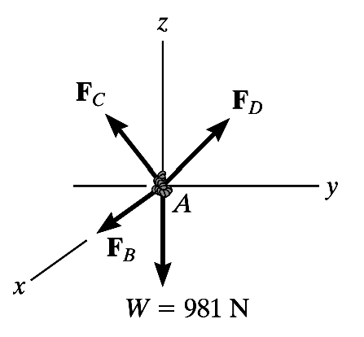
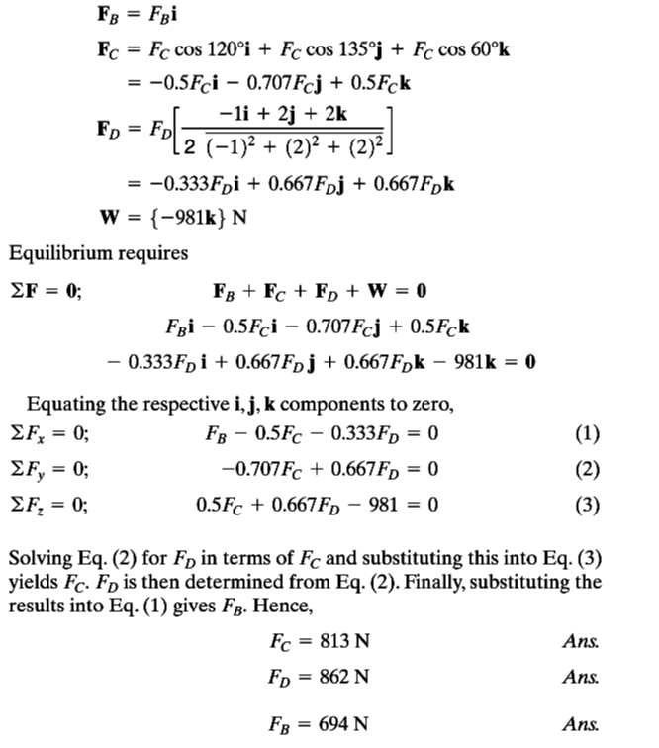
The force in each of the cords can be determined by investigating the equilibrium of
point A.The free-body diagram is shown in Fig. below. The weight of the crate is W =
100 *( 9.81) = 981 N.
Equations of Equilibrium.

